Slide 1
County cost share: A LOCALLY LED GRANT PROGRAM
February 27, 2021
michele sadauskas, county conservationist, oneida county land & water conservation dept.
www.oclw.org

Slide 2
What’s on the Agenda?
WI Land & Water Departments
Cost Sharing
Driving with Ms. Michele

Slide 3
A Bit about WI Land & Water Departments
All 72 Wisconsin counties have a Land Conservation Committee and some form of Land & Water Dept.
Most Land & Water Departments receive cost share monies from the State (departments must request to receive). Counties receive monies based on: 3-yr record of cumulative spending of cost-share funds, 3-yr record of cumulative average under-spending, and the # of farmland acres.
Cost share monies are distributed to Counties yearly, and counties dictate how they are distributed (caps, project rankings, resource priorities, etc.)

Slide 4
Exactly what is cost Sharing?
This is easy!
It’s the sharing of costs.

Slide 5
But, not so fast….
There are ALWAYS rules…..
Here are Oneida County’s:
We don’t pay more than 50% of the cost of the project
Our cost share cap is currently$8000 per project
Funds are reimbursed after the contractor is paid and we have “signed off” on the project
Installed practices must remain in place for 10 years
A contract and O&M (operation & maintenance agreement) needs to be signed between the County and landowner
We design the plan

Slide 6
Most Importantly…..
Our program’s #1 goal is to protect water quality and conserve soil resources and do so in a financially responsible way.

Slide 7
Ready to take a drive with Ms. Michele?
LET’S GO. . . . . . . .

Slide 8
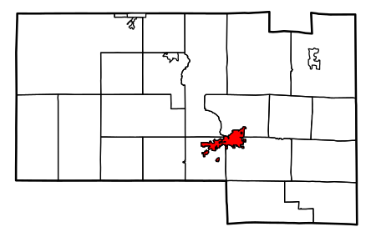
Our First Stop . . . . .
LAKE NOKOMIS
NEAR TOMAHAWK

Slide 9
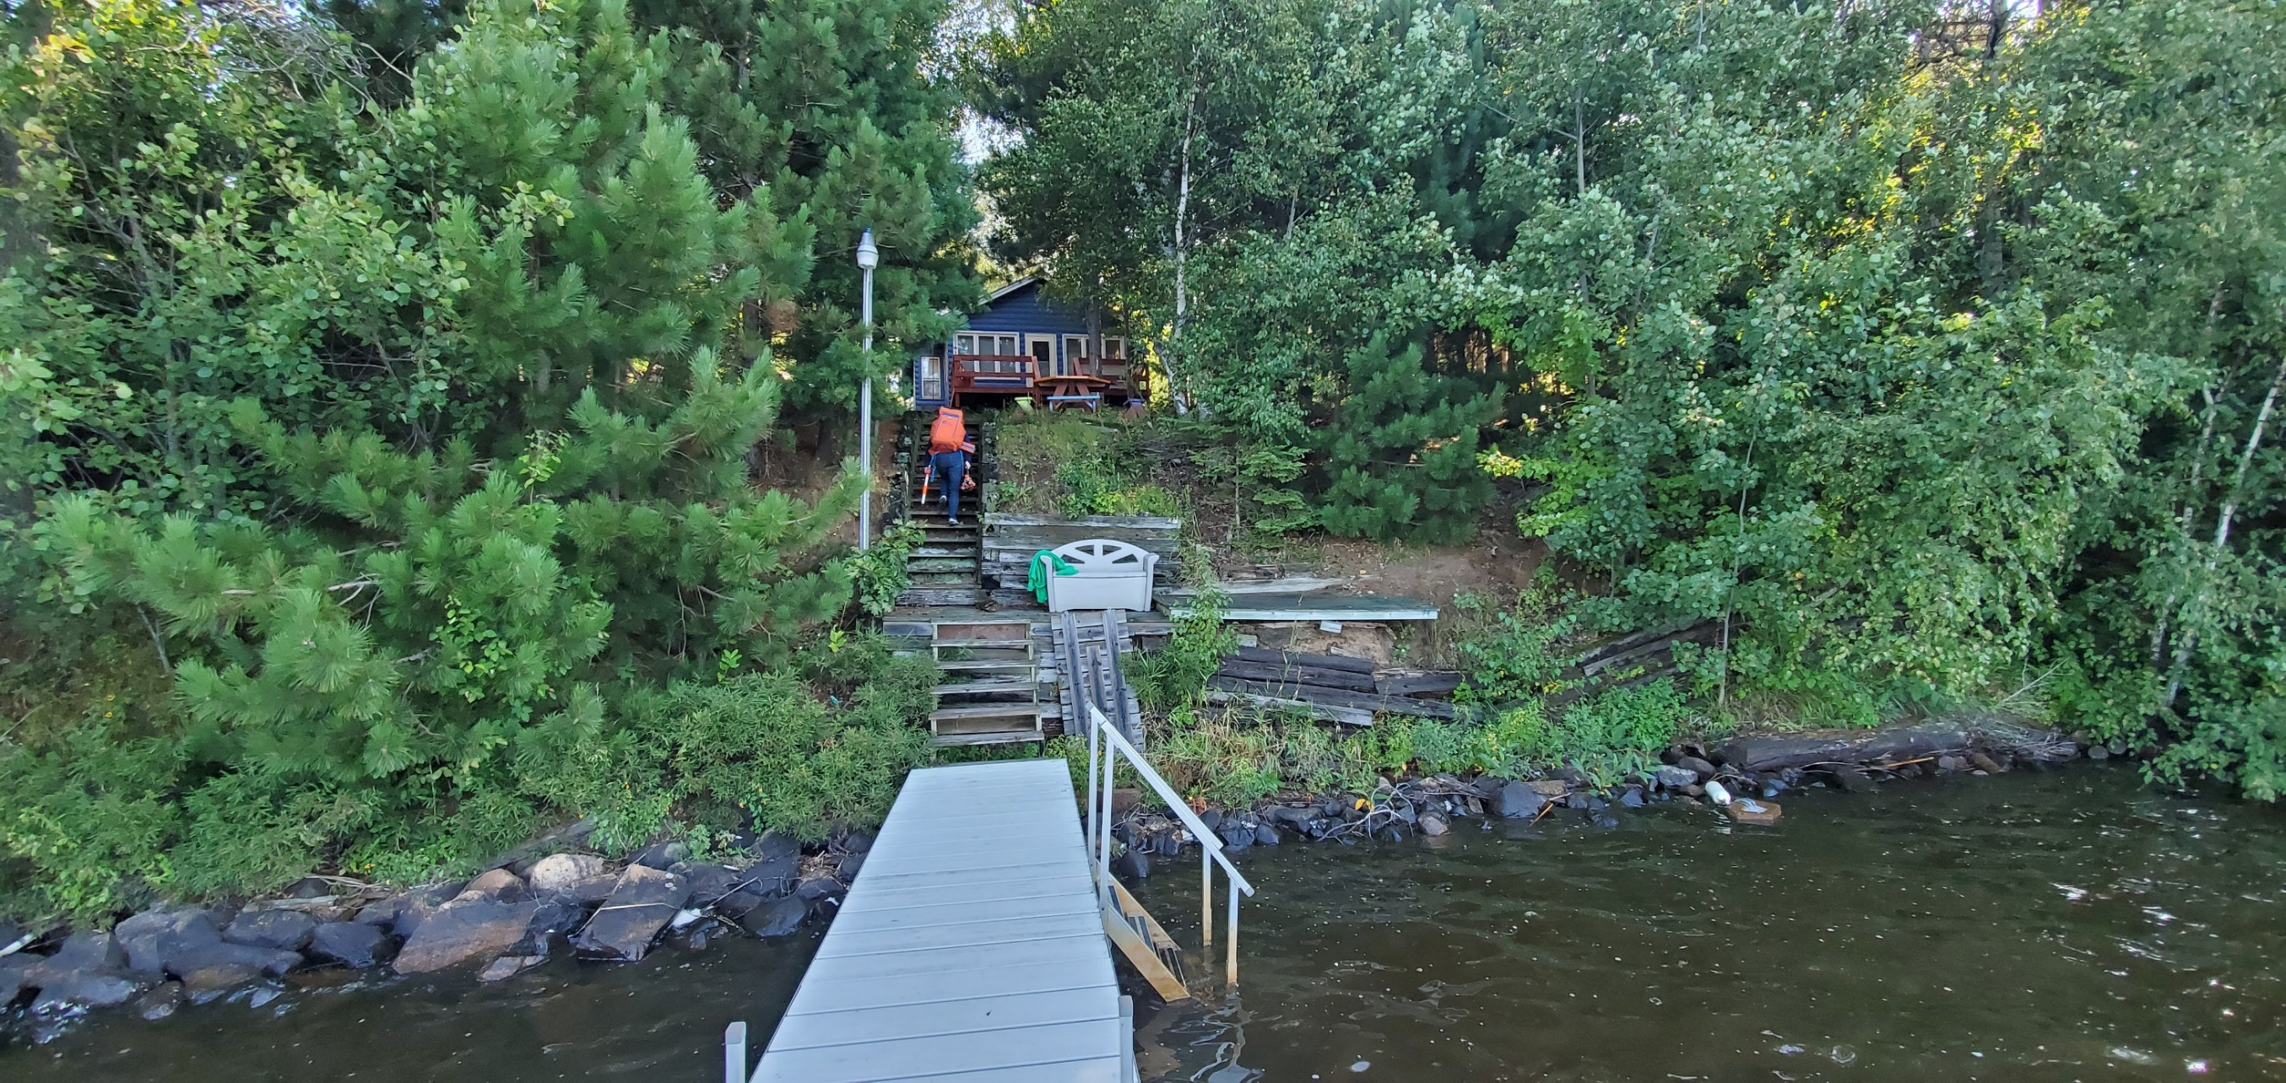
Lake Nokomis Site visit # 1

Slide 10
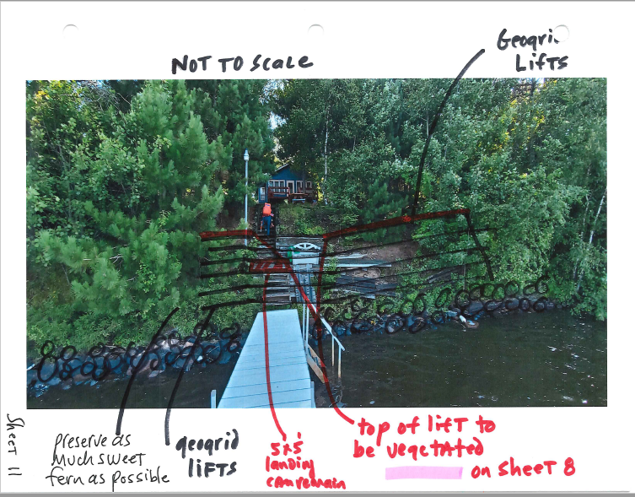

Slide 11
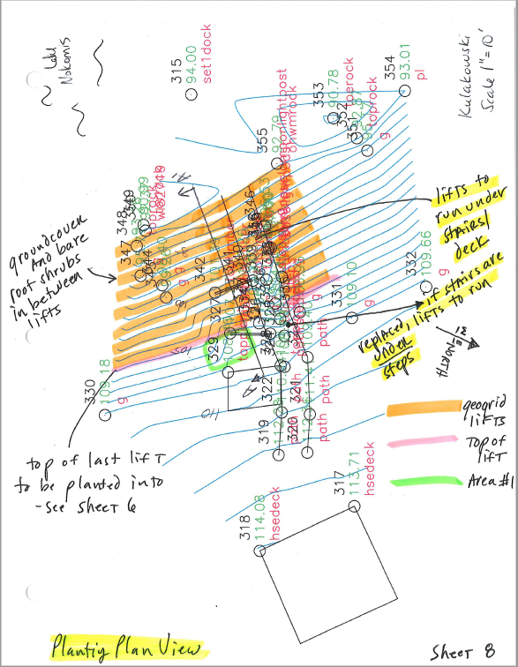

Slide 12
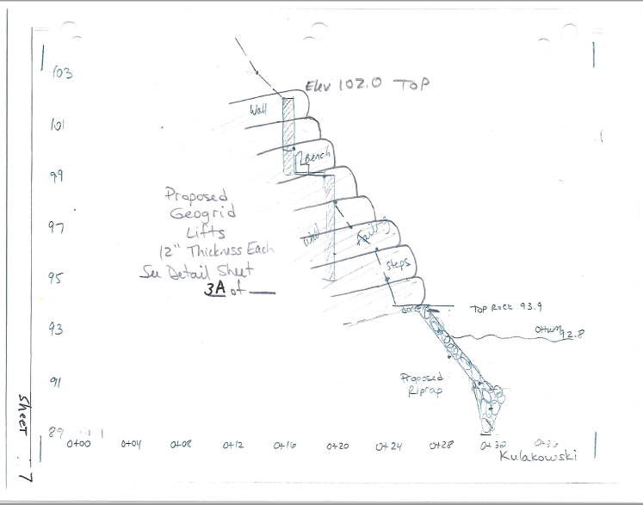

Slide 13
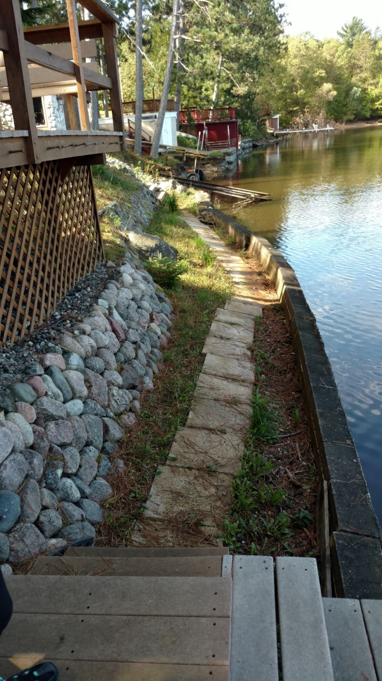
Lake Nokomis
Site visit # 2
before

Slide 14
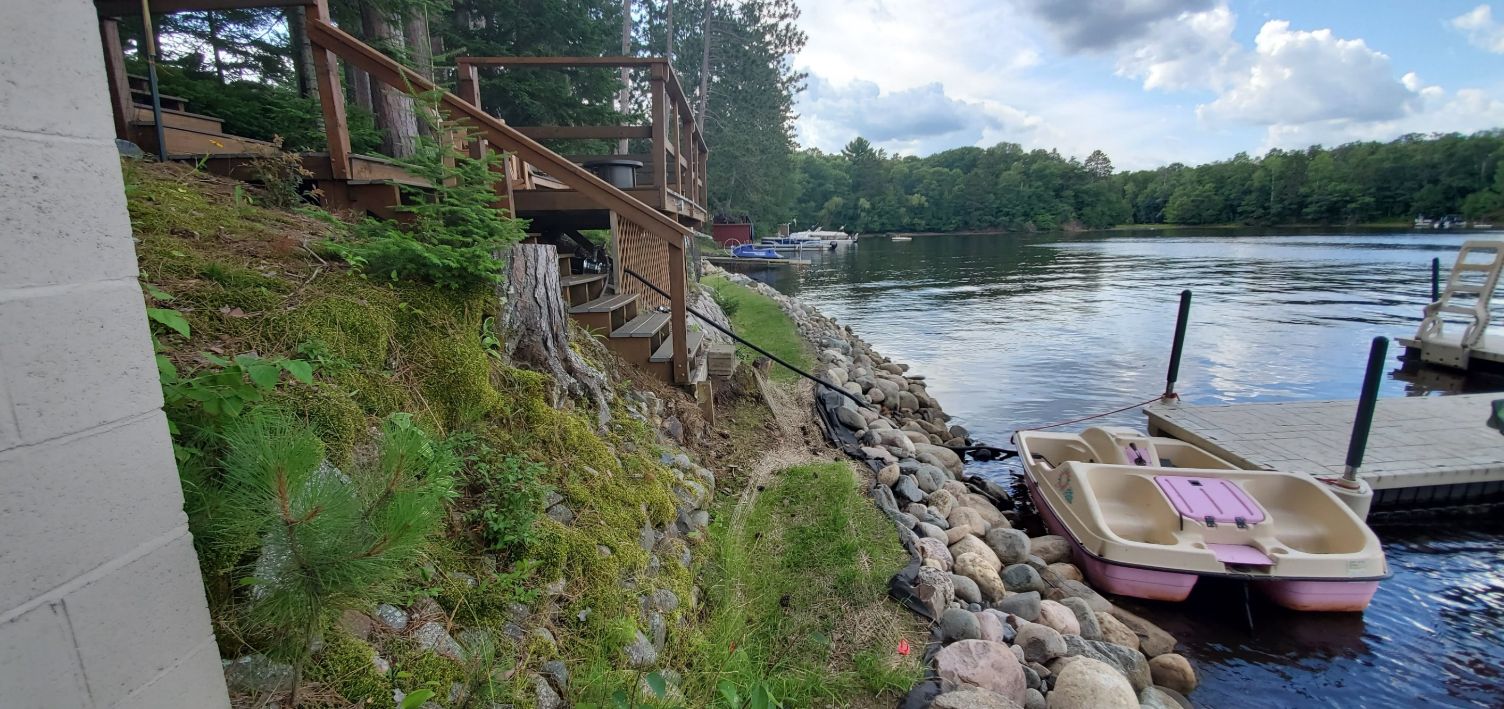
Lake Nokomis Site visit # 2 after

Slide 15
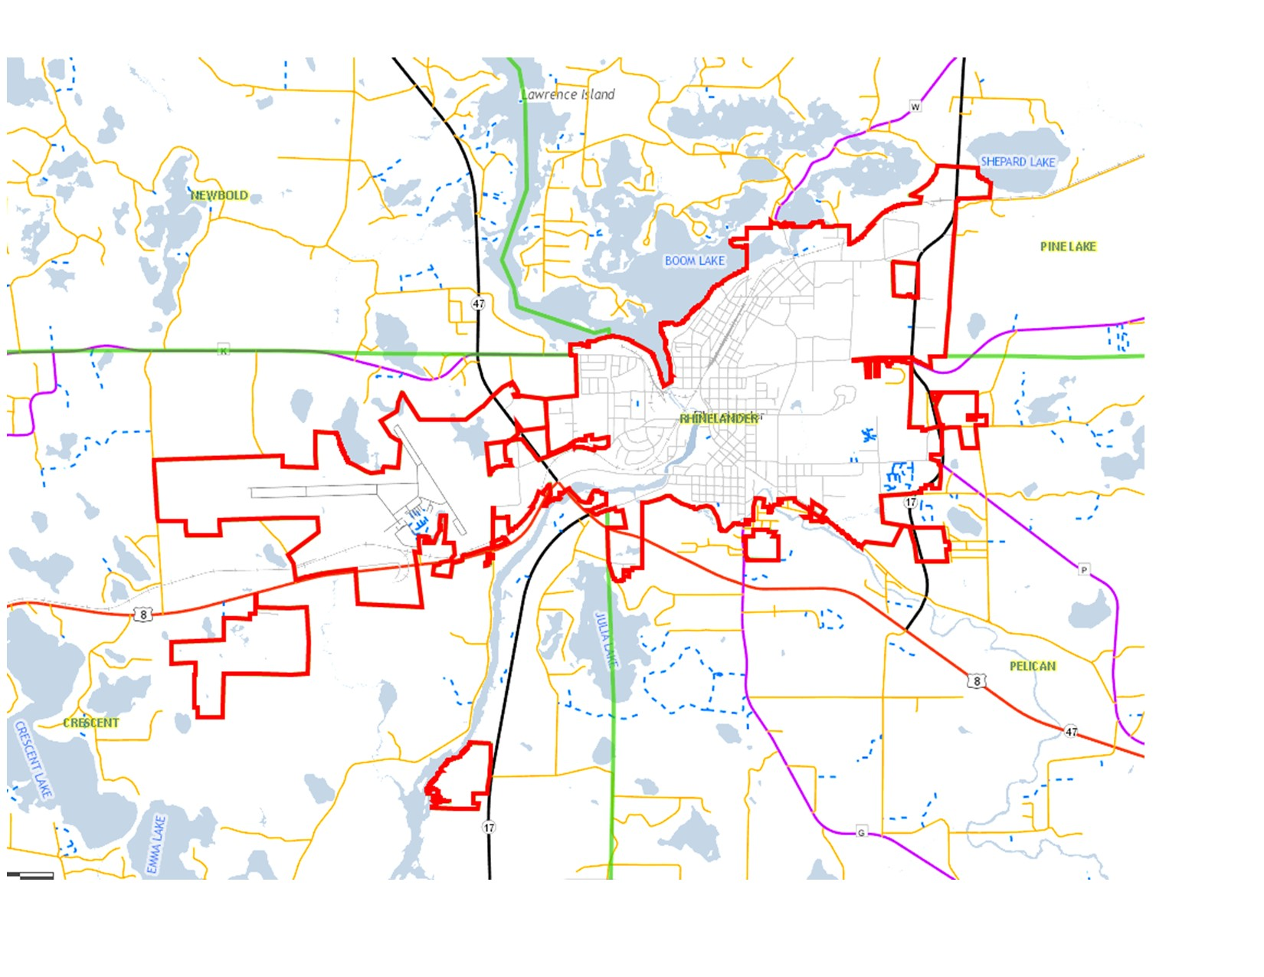
Next we’ll travel to . . .
NEAR RHINELANDER

Slide 16
HANCOCK LAKE

Slide 17
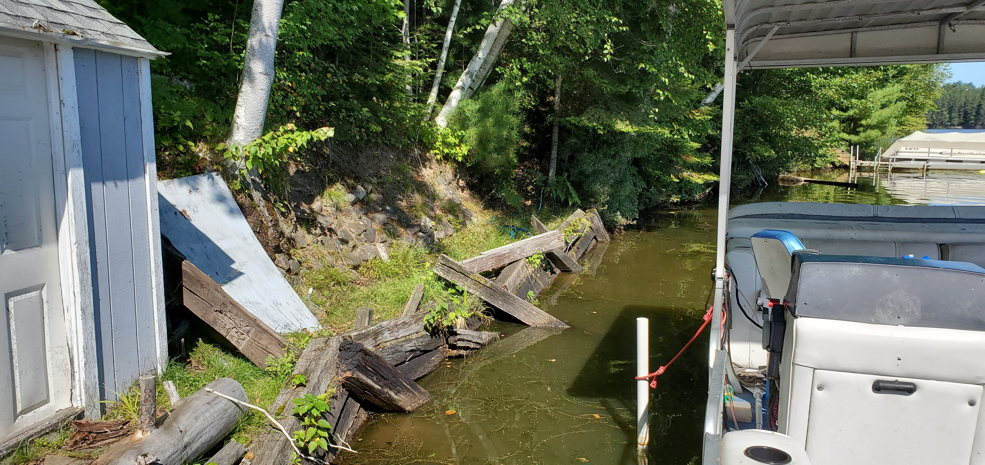
Hancock Lake Site visit # 3

Slide 18
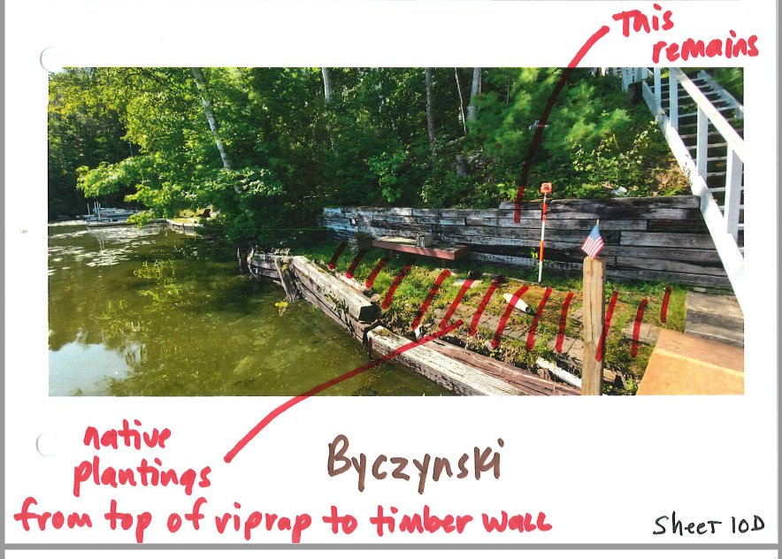

Slide 19
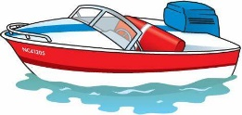
WISCONSIN RIVER

Slide 20
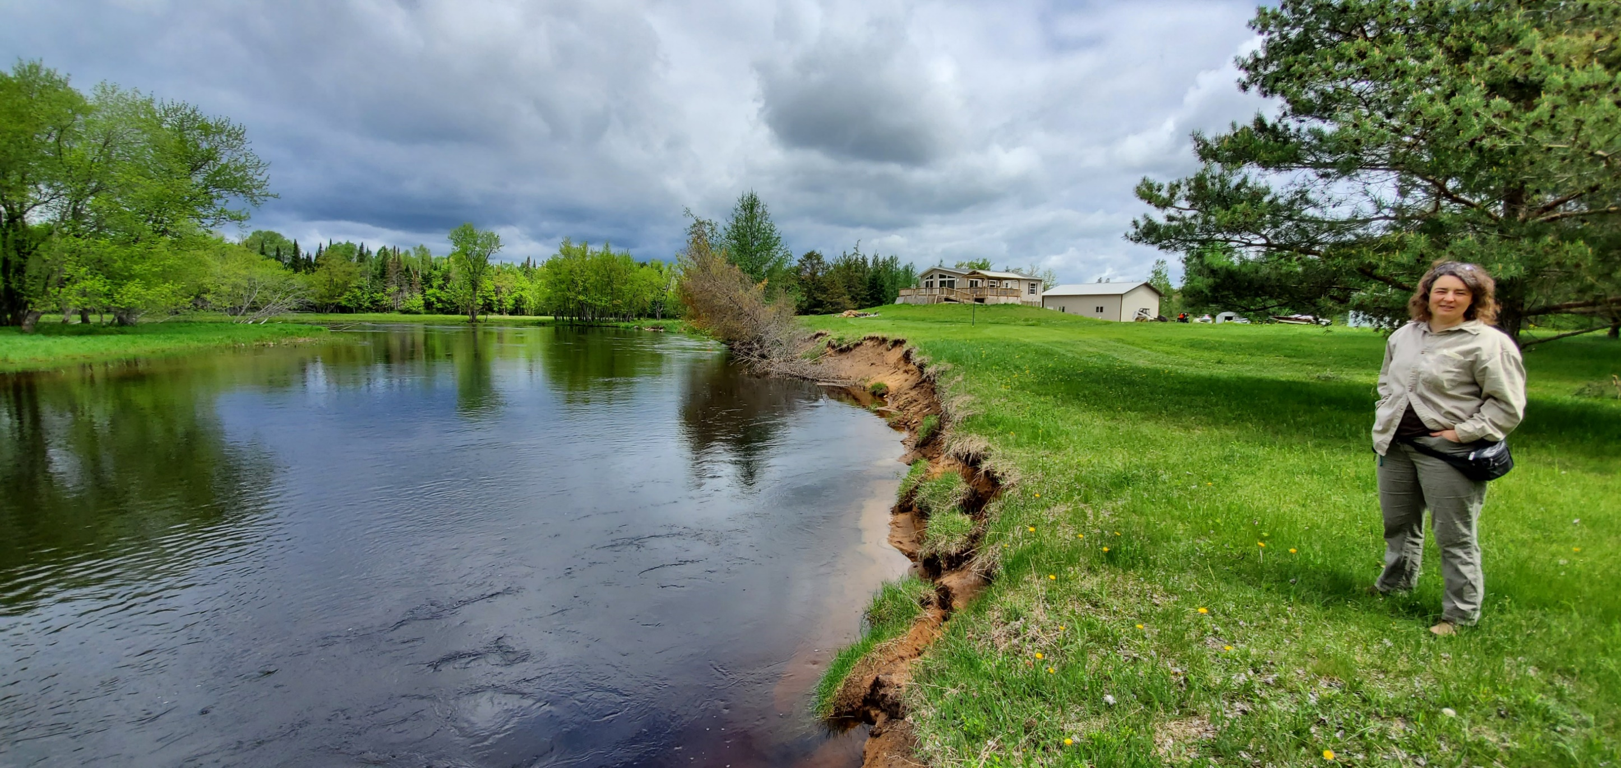
WI River Site visit # 4

Slide 21
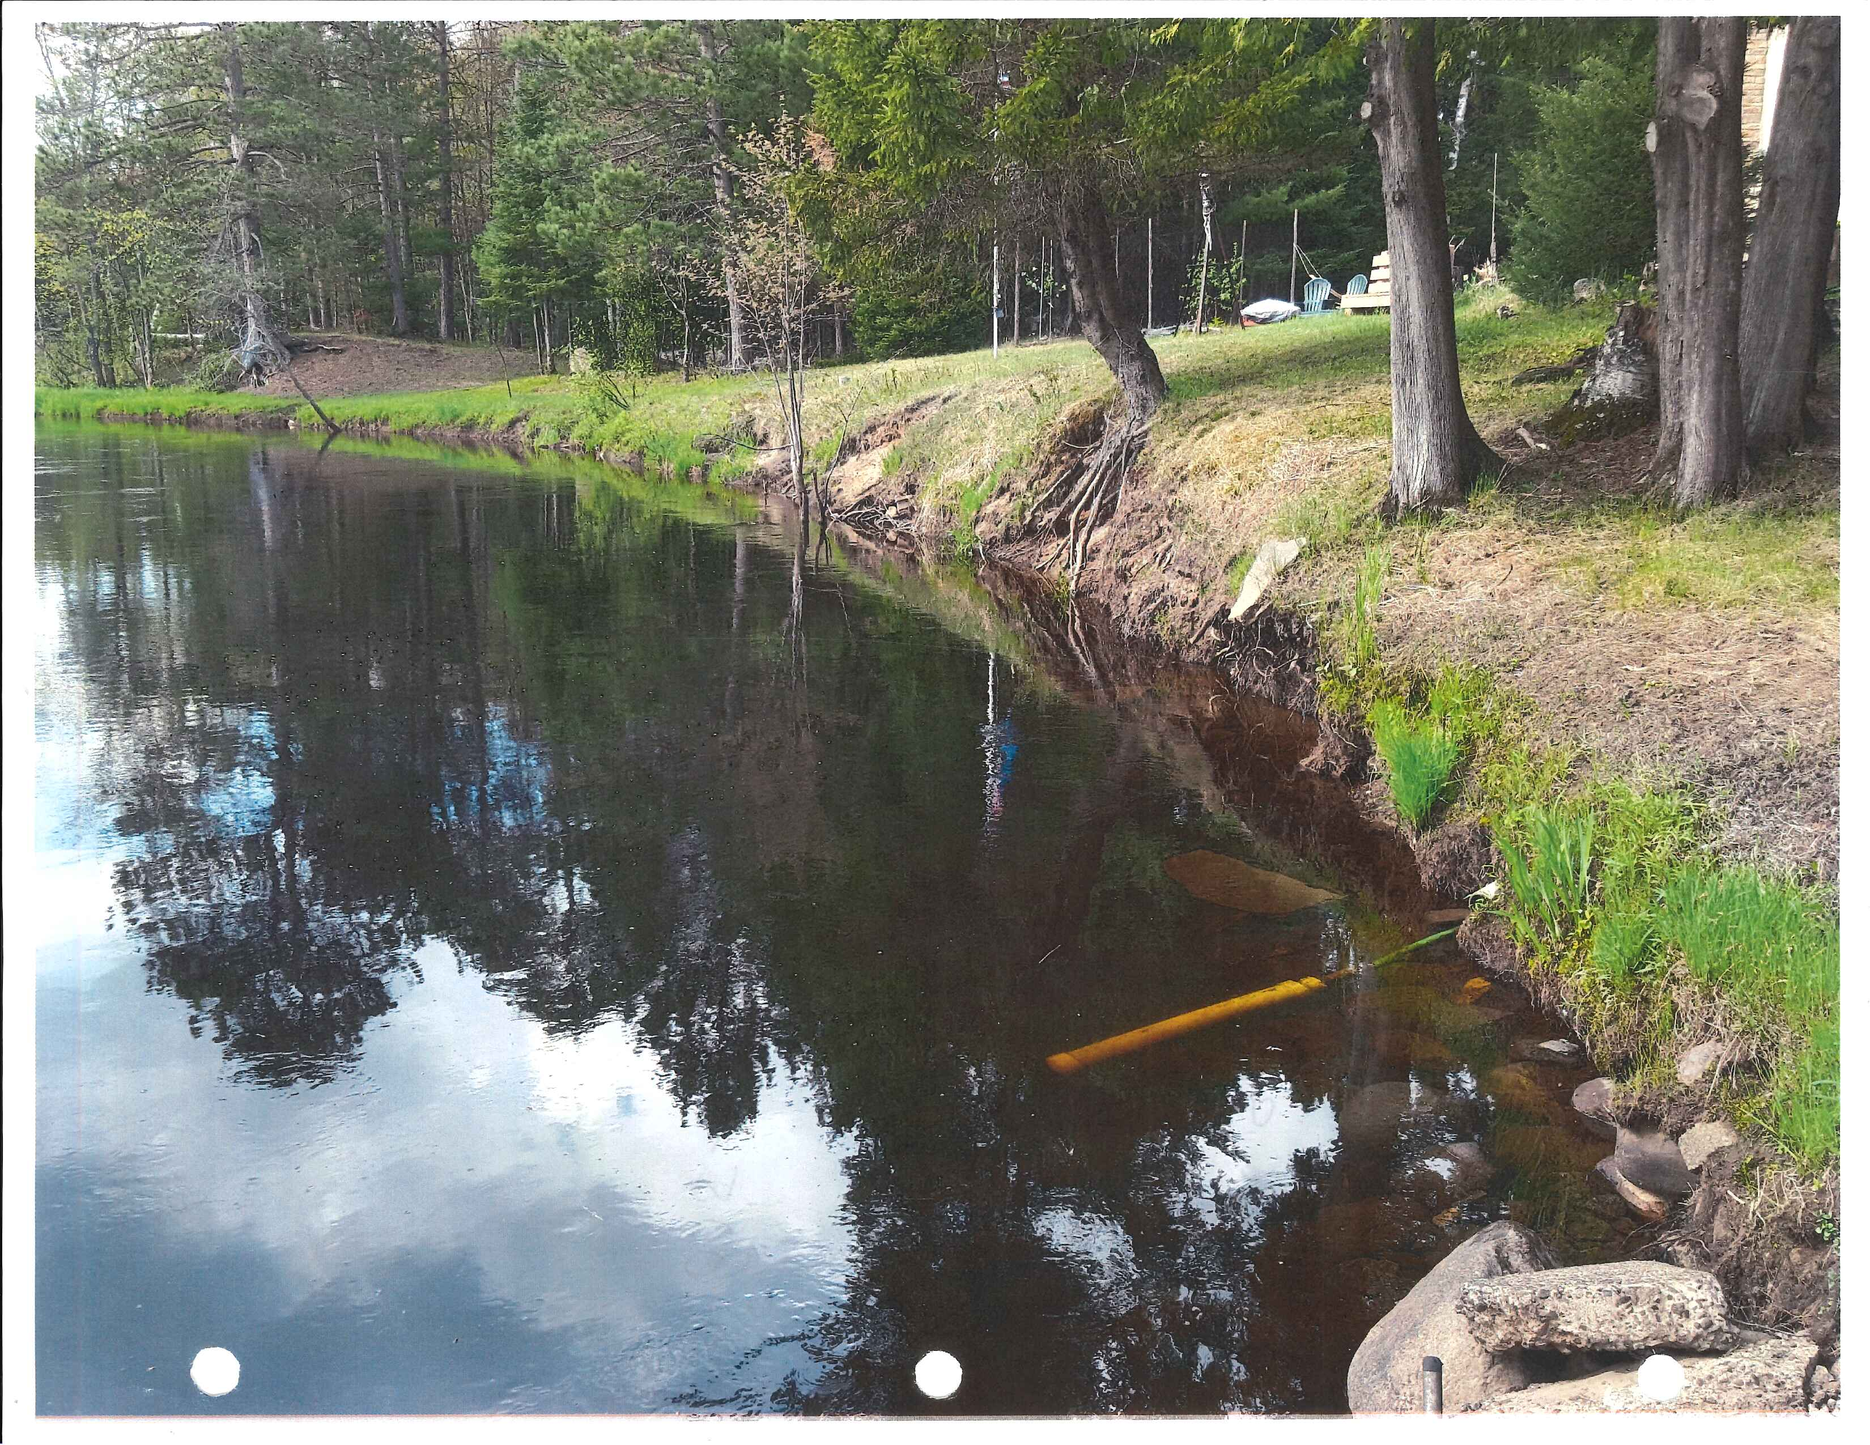
WI River Site visit # 5 before

Slide 22
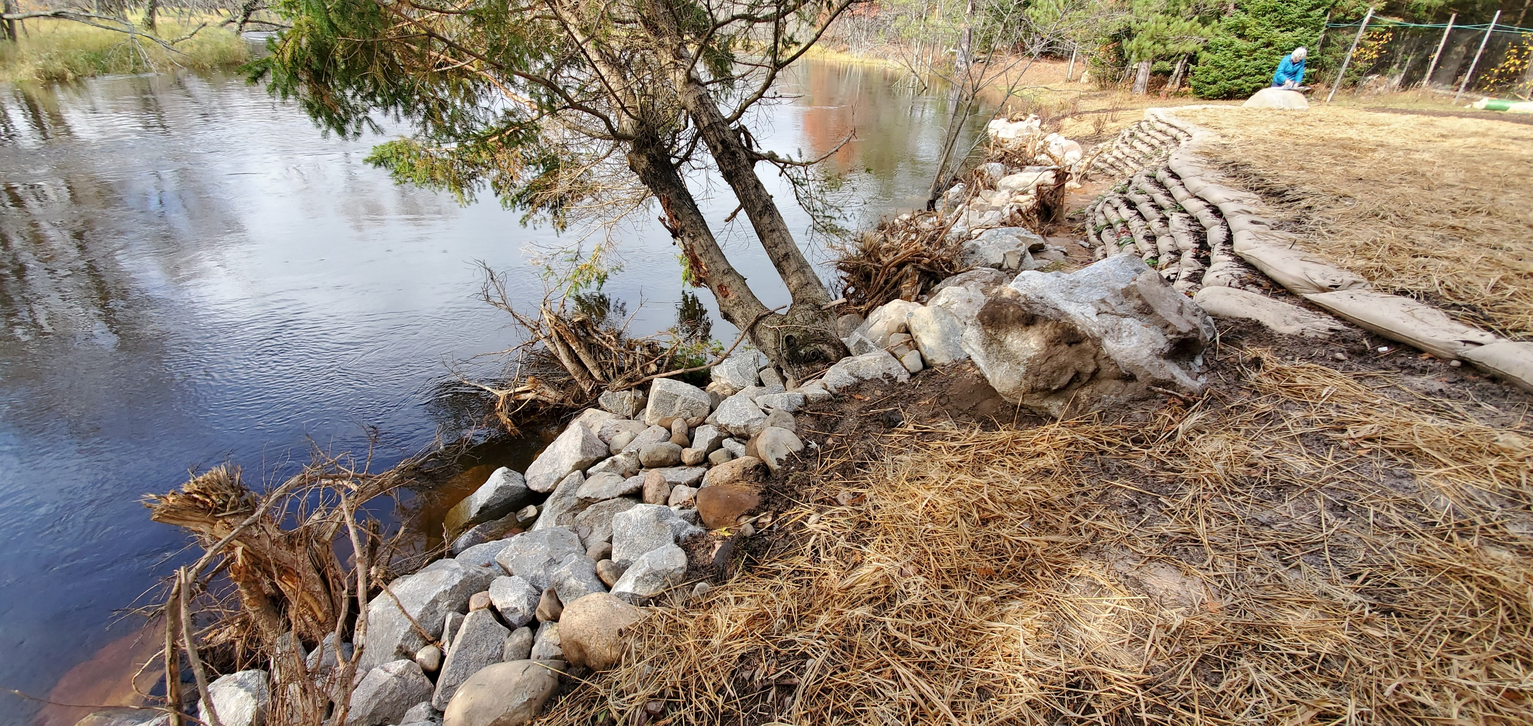
WI River Site visit # 5 after

Slide 23
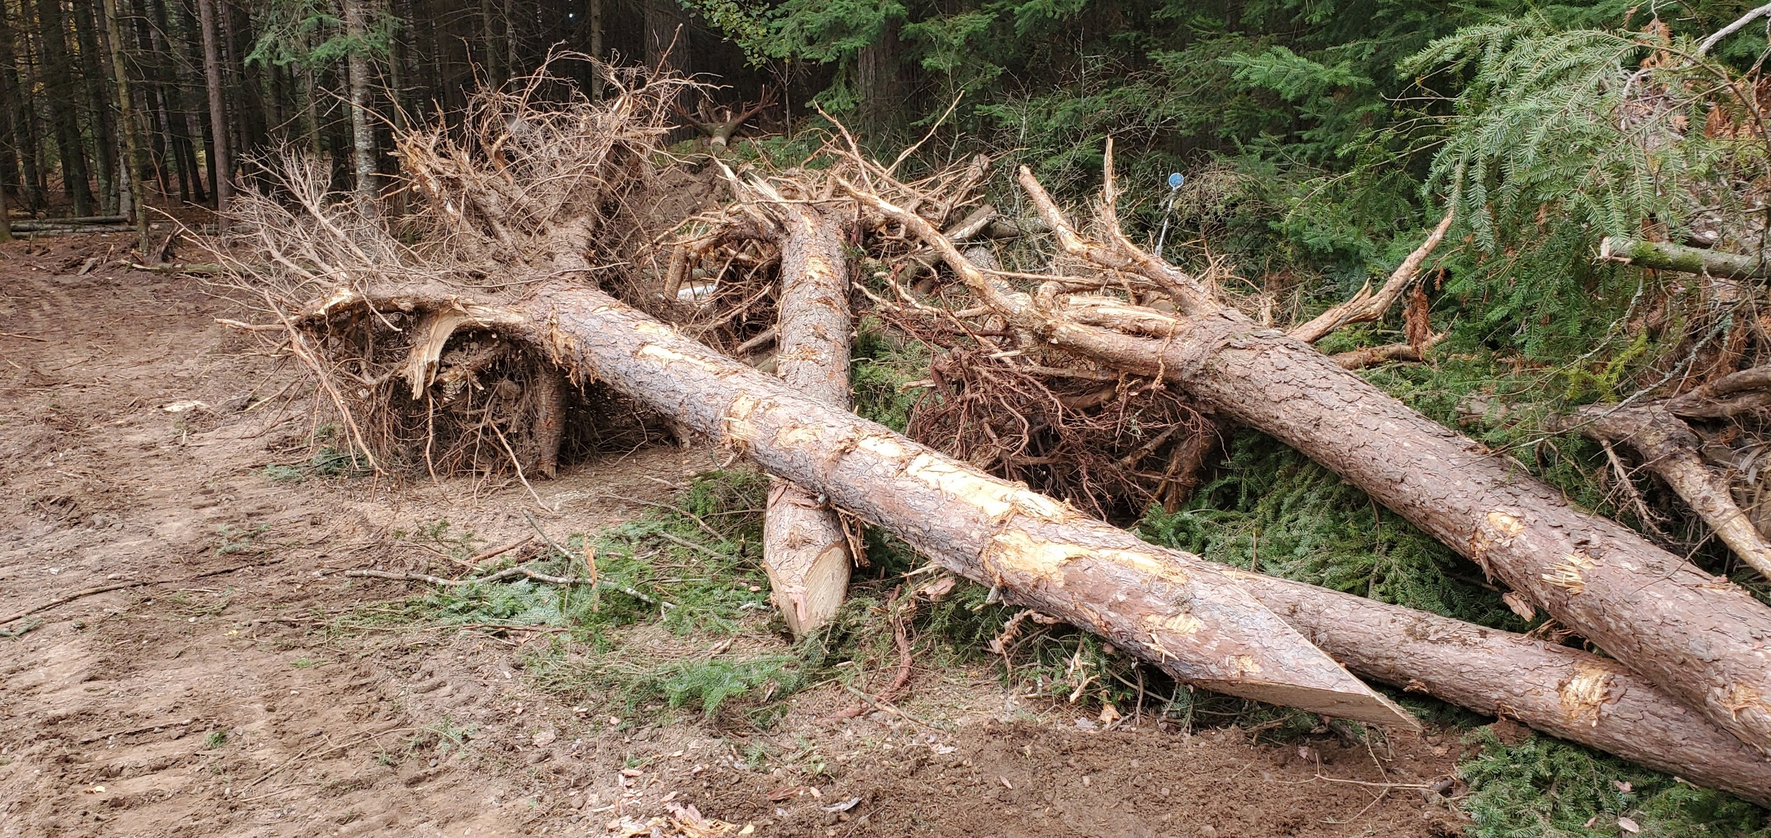

Slide 24
PELICAN LAKE

Slide 25
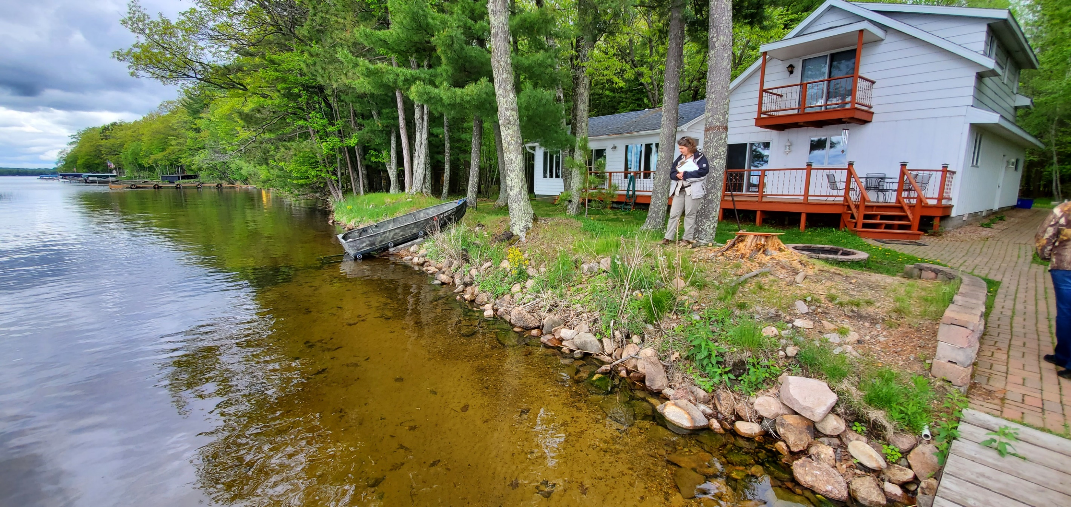
Pelican Lake Site visit # 6

Slide 26
Then…off to . . . .
THOROUGHFARE
THREE LAKES

Slide 27
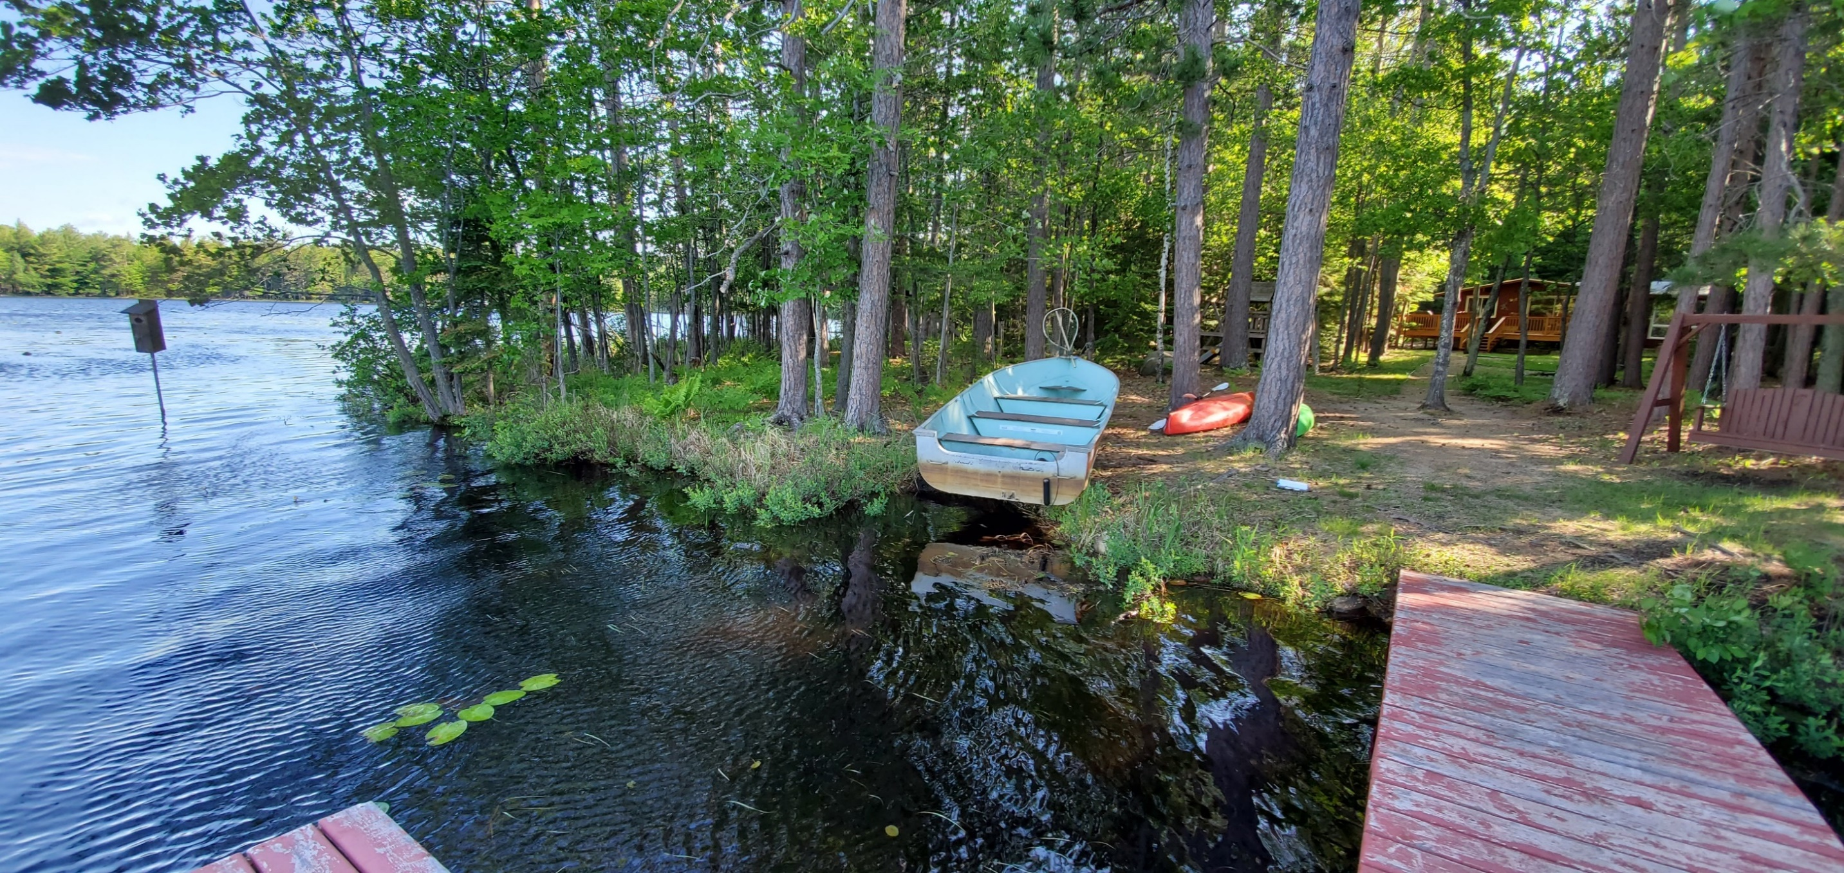
Thoroughfare Site visit # 7

Slide 28
With a quick stop in . . .
ST. GERMAIN
PICKEREL LAKE

Slide 29
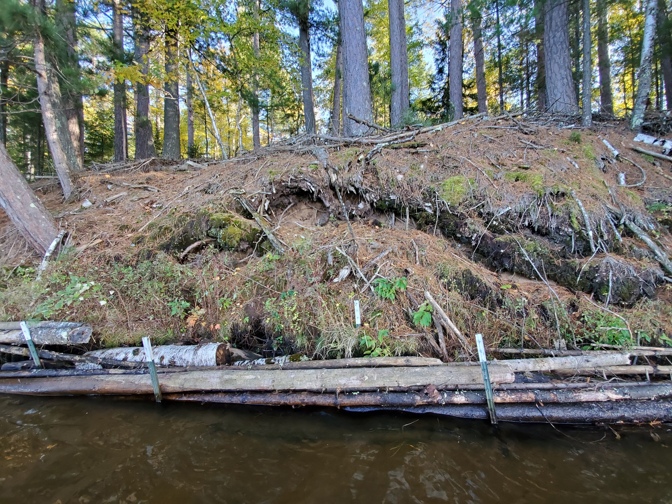
Pickerel Lake Site visit # 8

Slide 30
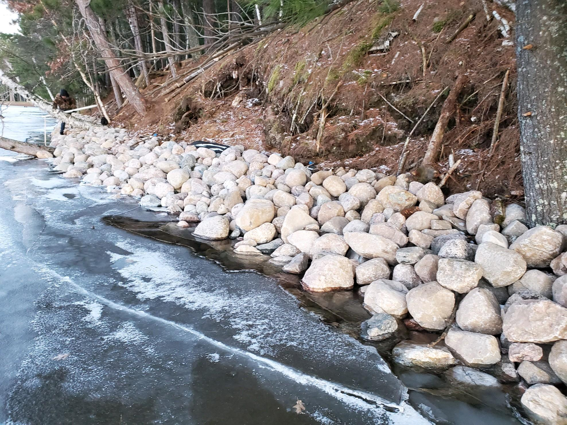

Slide 31
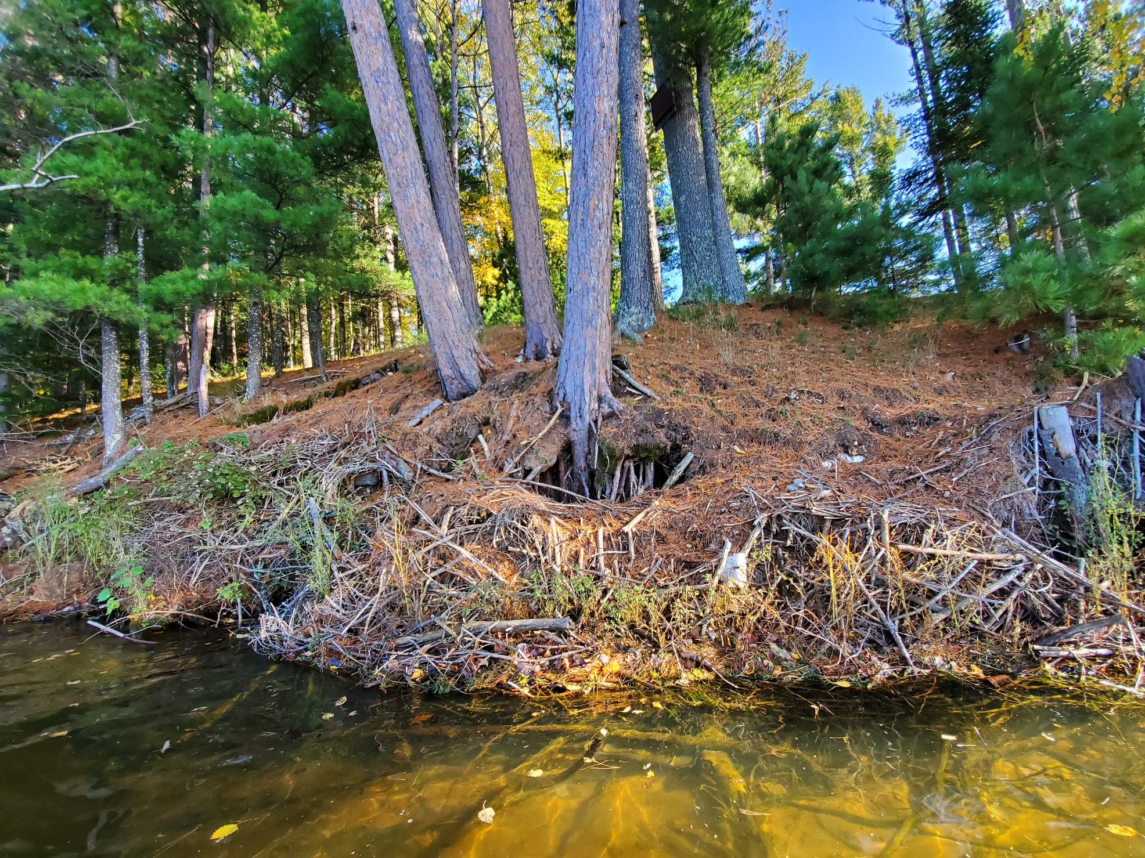
Pickerel Lake Site visit # 8
….time to let Mother Nature take it’s course…..

Slide 32
And finally end up in. . . .
MINOCQUA
DIAMOND LAKE
KAWAGUESAGA LAKE
LAKE MINOCQUA

Slide 33
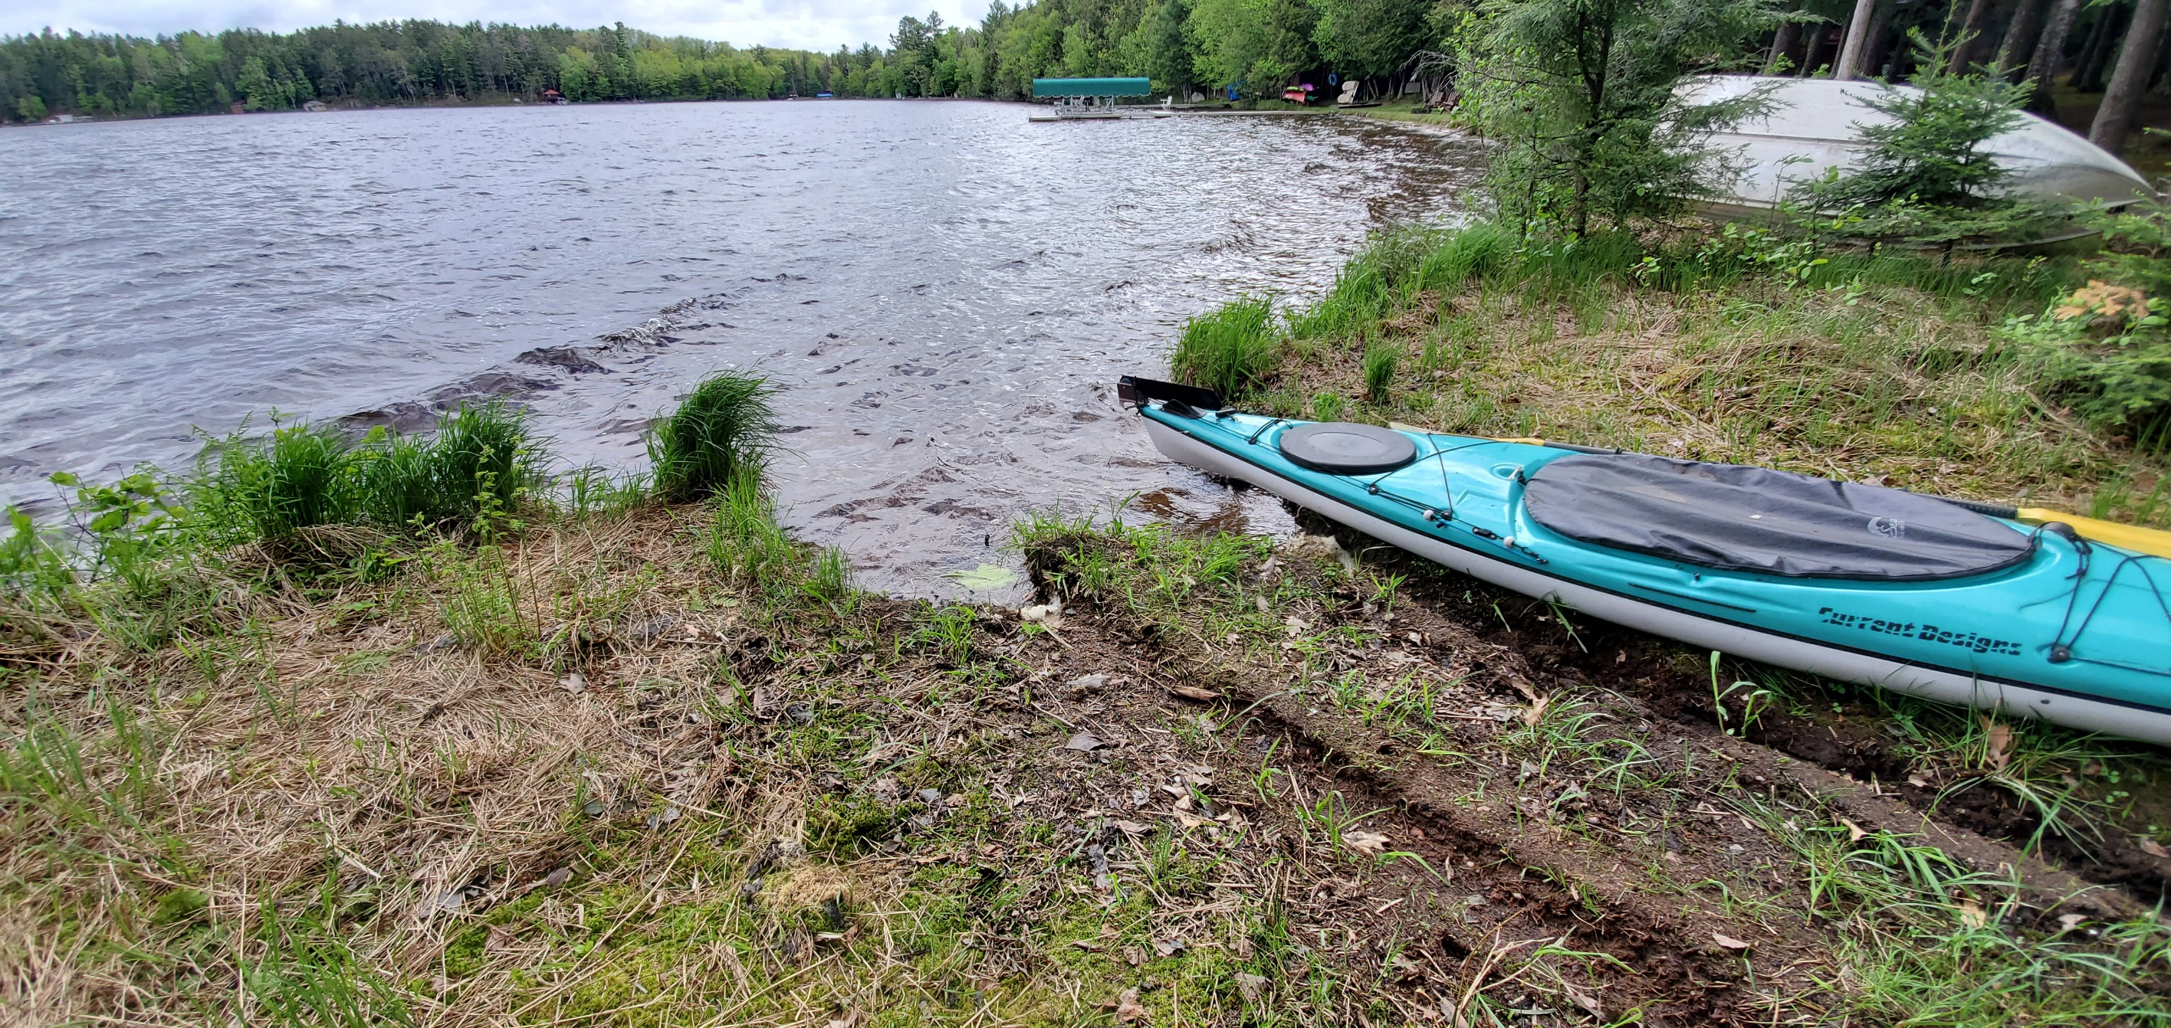
Diamond Lake Site visit # 9

Slide 34
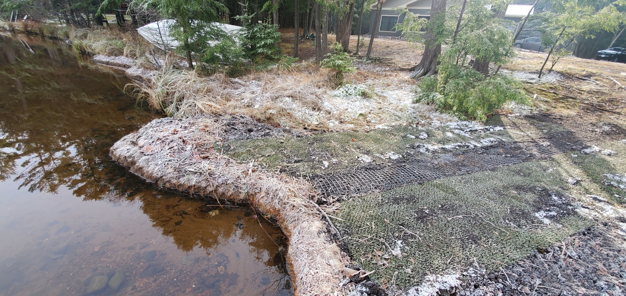

Slide 35
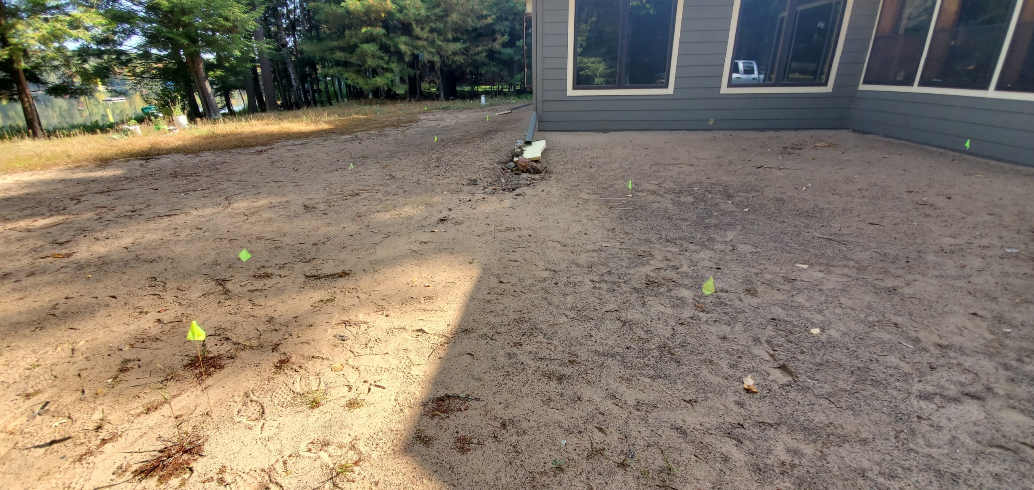

Slide 36
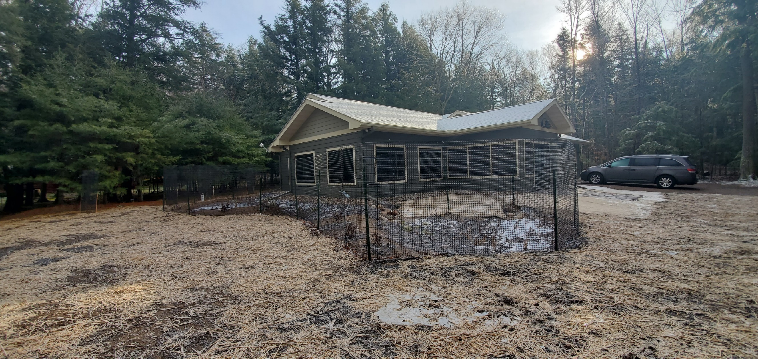

Slide 37
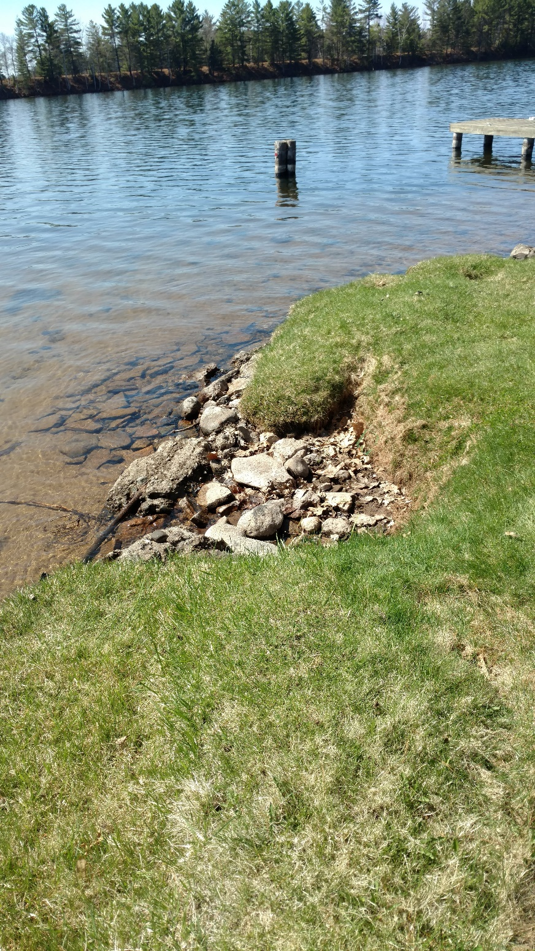
Lake Minocqua
Site visit # 10

Slide 38
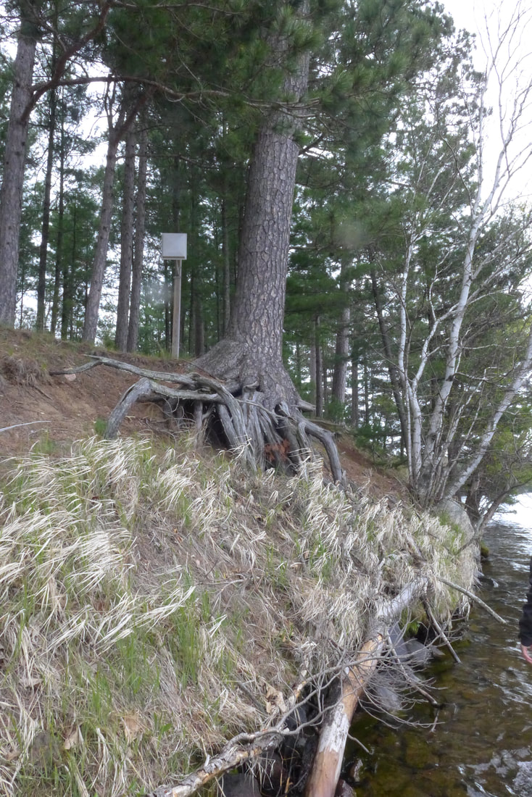
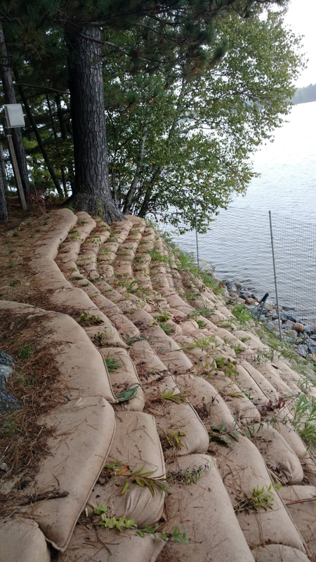
Lake Kawaguesaga
Site visit # 11

Slide 39
Hope you enjoyed our ride!

Slide 40
www.oclw.org

Slide 41
Thank you!
michele sadauskas
oneida county conservationist
715-369-7835
www.oclw.org

