Slide 1
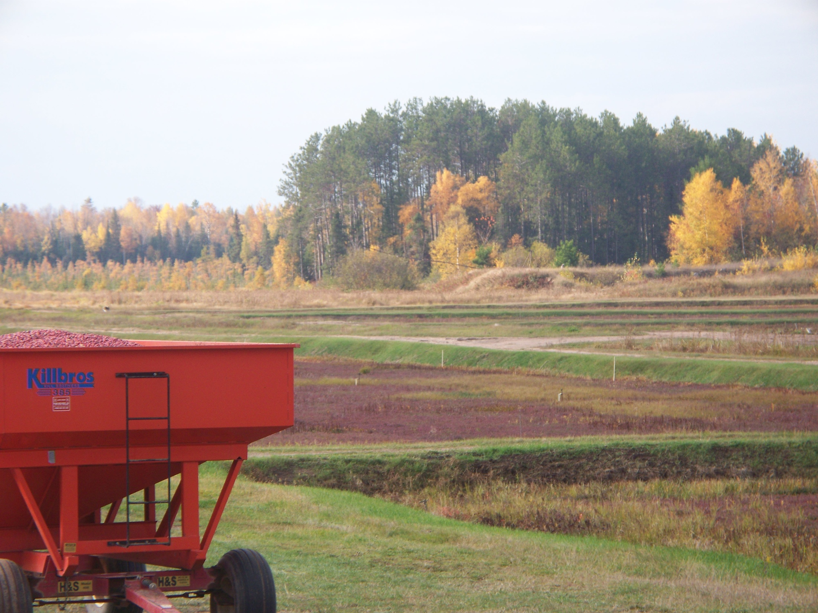

Slide 2
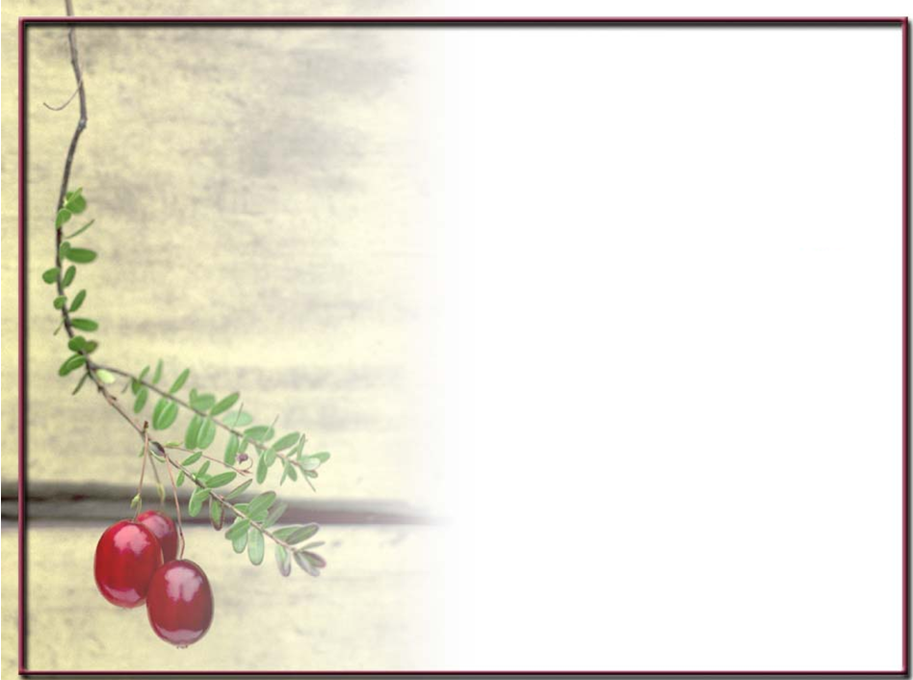
Managing Pollinators on a Cranberry Marsh

Slide 3
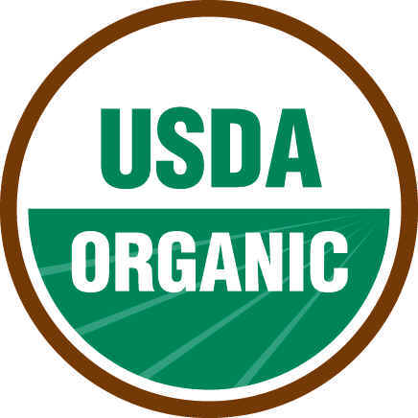
James Lake Farms
Family Owned
Grower and Packer of Organic Cranberries
Fresh and Frozen

Slide 4
2 farm locations
65 acres certified organic
124 acres in transition to organic

Slide 5
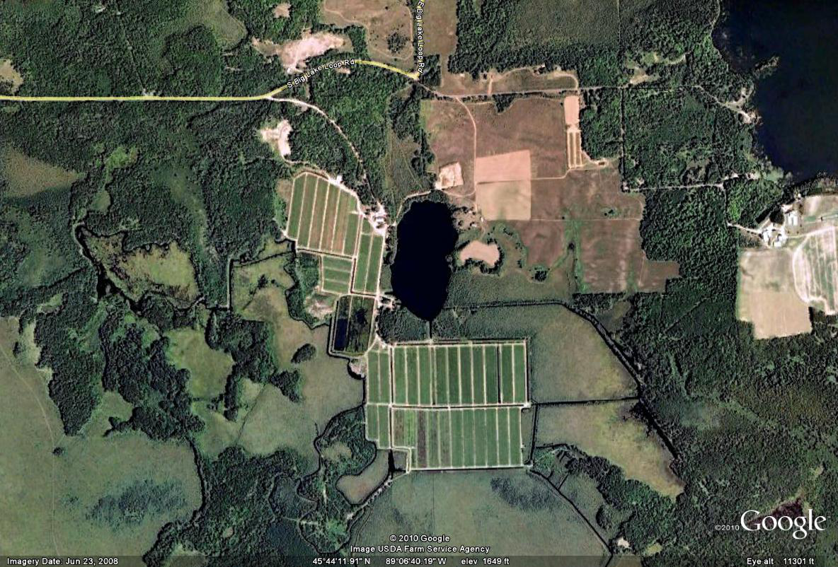

Slide 6
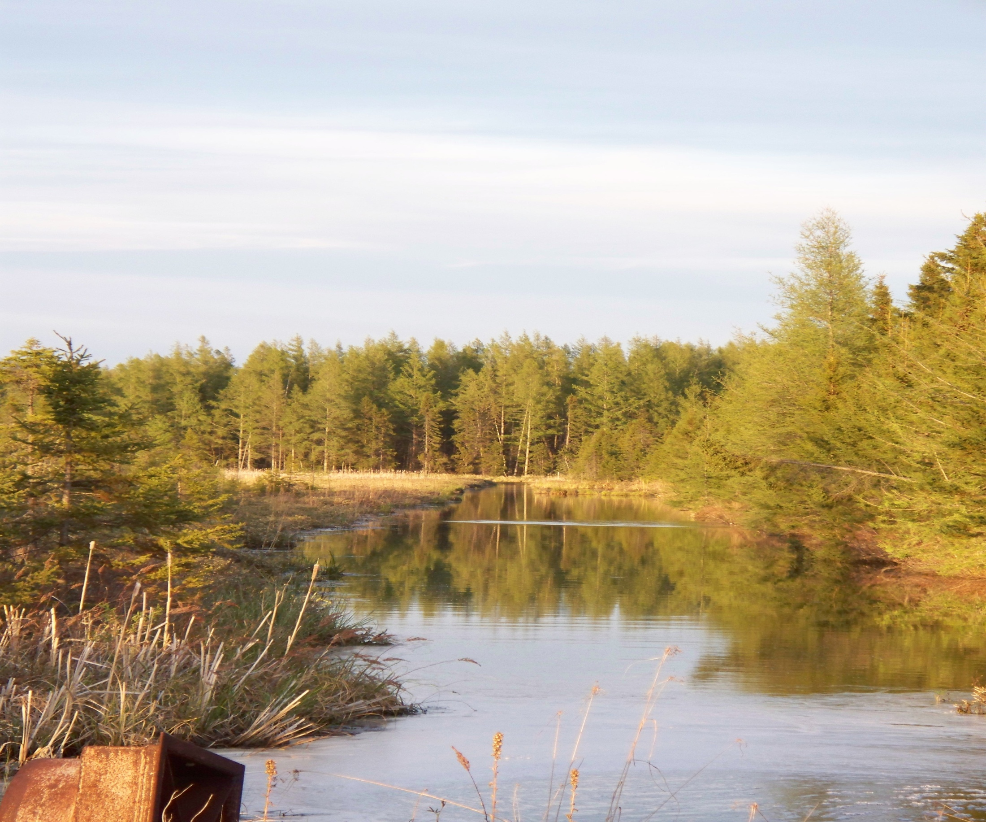

Slide 7
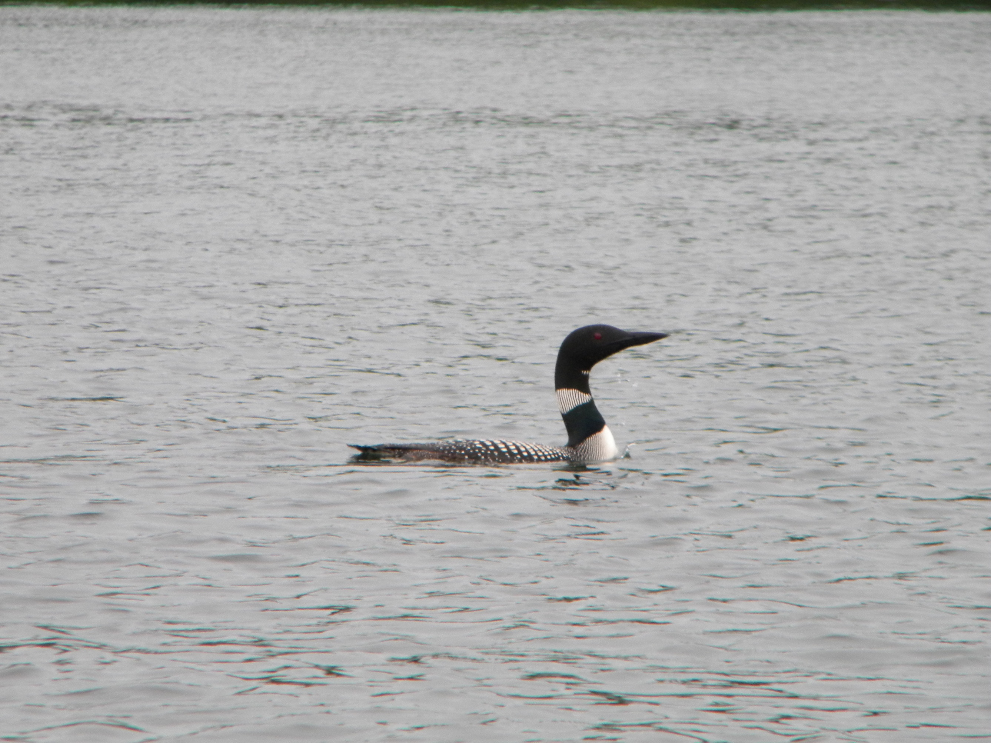

Slide 8
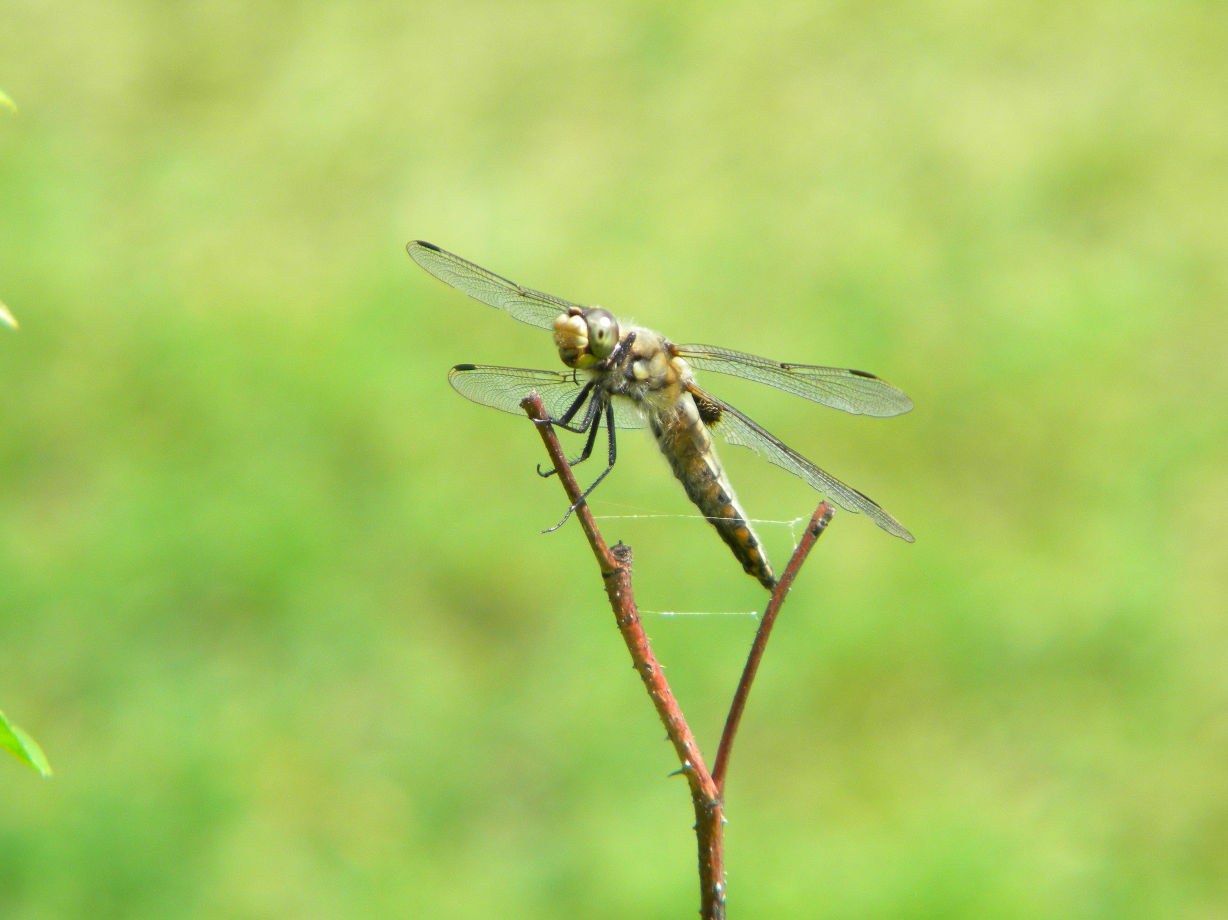

Slide 9
The Cranberry Plant
Perennial

Slide 10
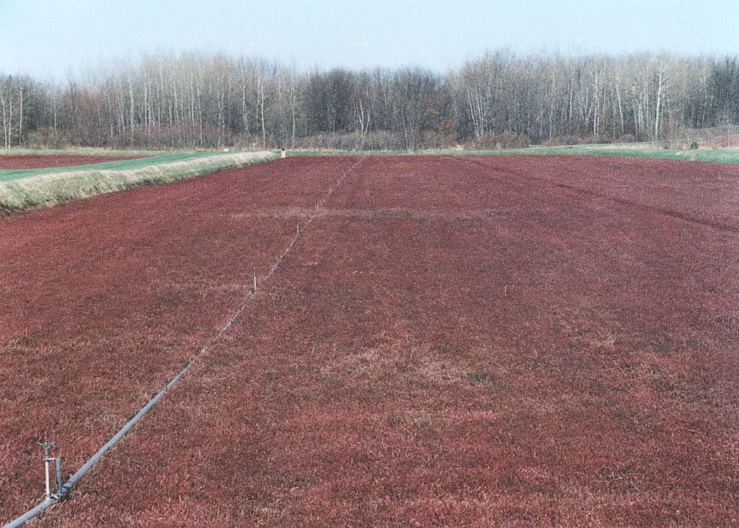

Slide 11
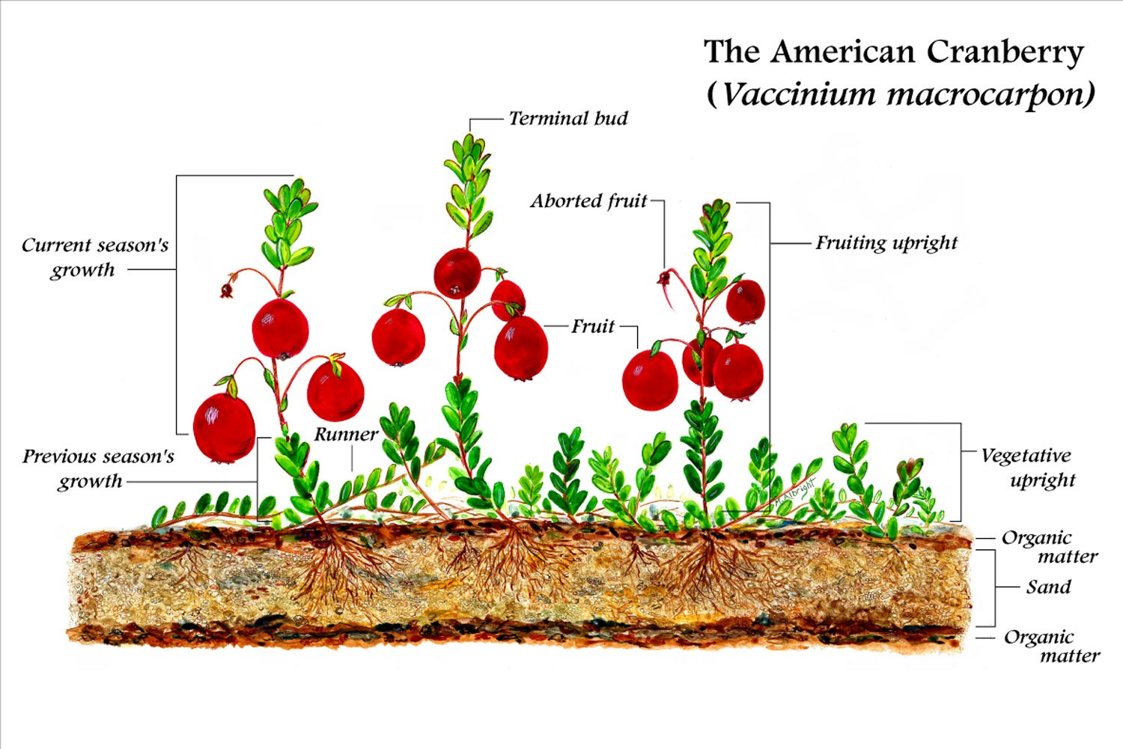

Slide 12
The Cranberry Plant
Perennial
Vaccinium macrocarpon
One of three native fruit crops grown commercially in North America
Requires pollinator activity to grow commercial yields

Slide 13
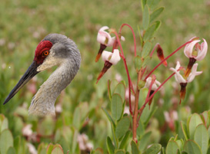

Slide 14
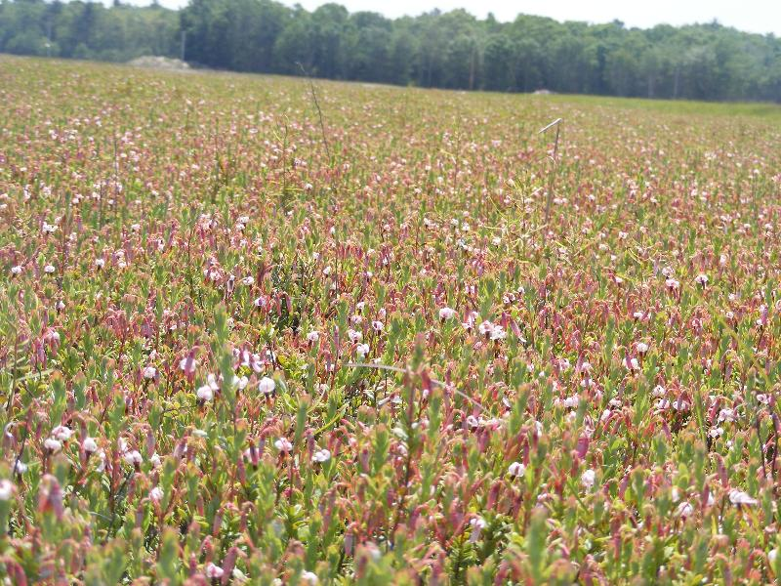

Slide 15
Pollination Challenge
On our 189 acres of planted cranberries, we can have up to 2,000,000,000 blossoms

Slide 16
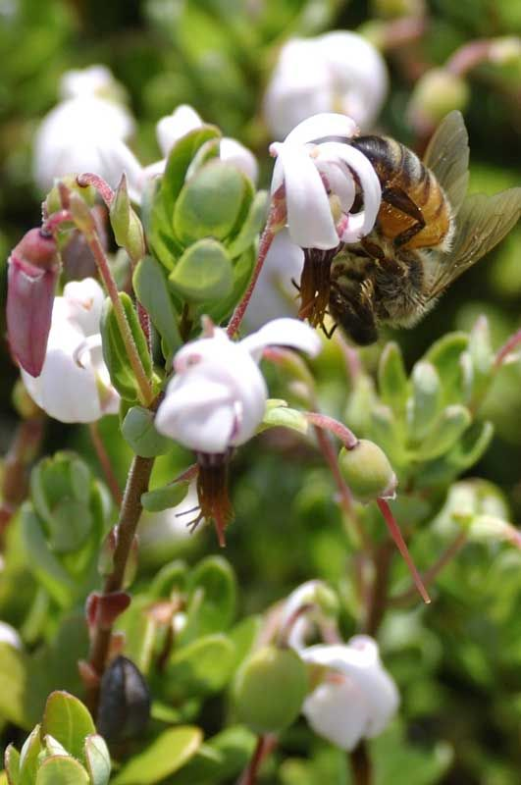
About 40-50% of blossoms “set” to become berries
A viable berry will require at least 8 pollen tetrads to germinate

Slide 17
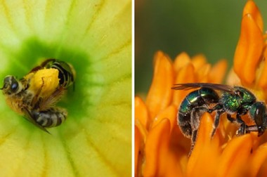
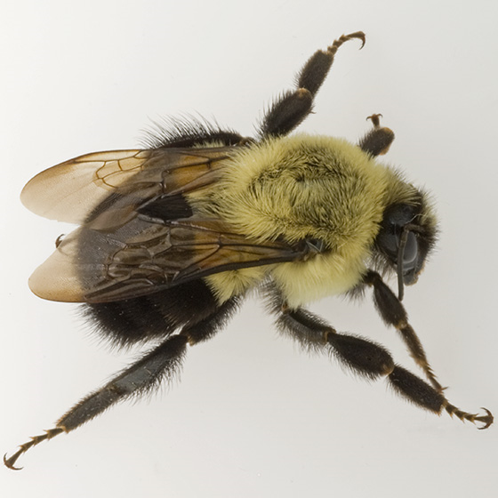
Native Pollinators
Commercial Bumblebees
Honeybees

Slide 18
Typically staged at 2 hives/acre
Pros
Number of bees in the hive
Cons
Honey bees facing multiple threats
Expensive
Nectar and pollen collectors
Selective Feeders
Need good weather to work
Honeybees

Slide 19
Typically staged at 2.5 hives/acre
Pros
Work in a wide range of conditions
Pollen collectors
Buzz pollinators
Commercial Bumblebees
Cons
Lower number of bees/hive

Slide 20
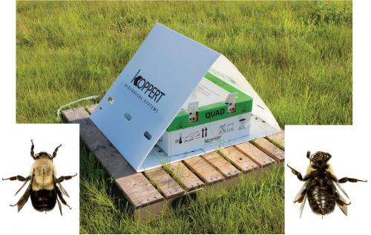

Slide 21
Pros
No staging or deployment
No $
Diversity of species
Native Pollinators
Cons
Highly variable population

Slide 22
Goal is to maximize cranberry pollination while maintaining a balanced ecosystem
Encourage Diversity
Manage the entire property, not just the cranberry bed
Conserve the pollinator and pollinator plants you have
Augment what you don’t have

Slide 23
Pollination – 3 Windows of Management
Pre-Season prior to Cranberry Blossom
Cranberry Blossom
Post Season after Cranberry Blossom

Slide 24
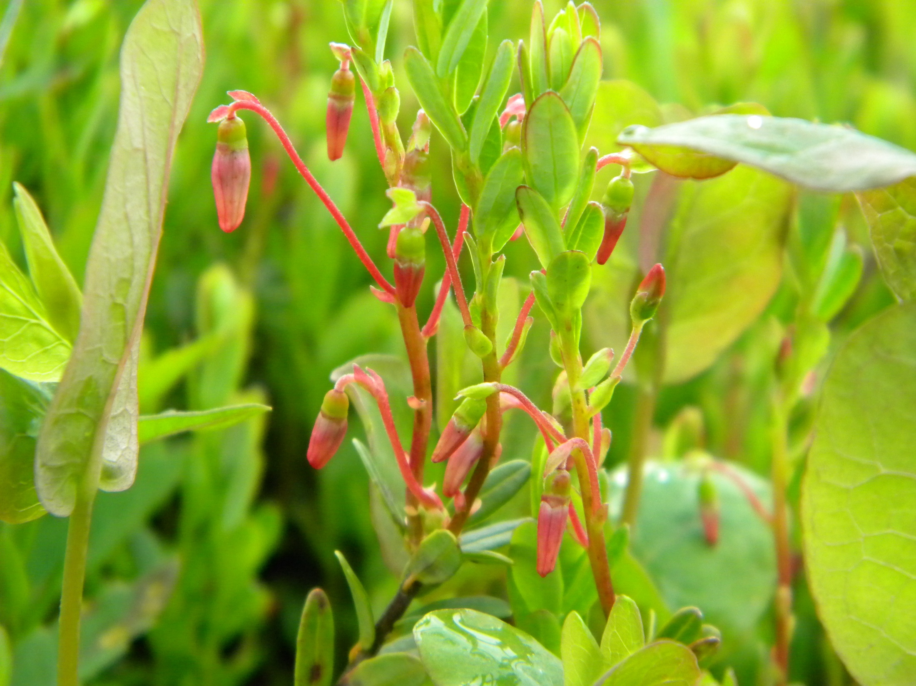

Slide 25
Pre-Season before Cranberry Blossom
Important to build up populations quickly

Slide 26
Pre-Season before Cranberry Blossom
Strategies
Encourage early pollen and nectar sources on the whole property

Slide 27
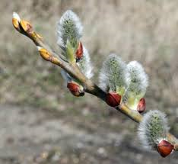

Slide 28
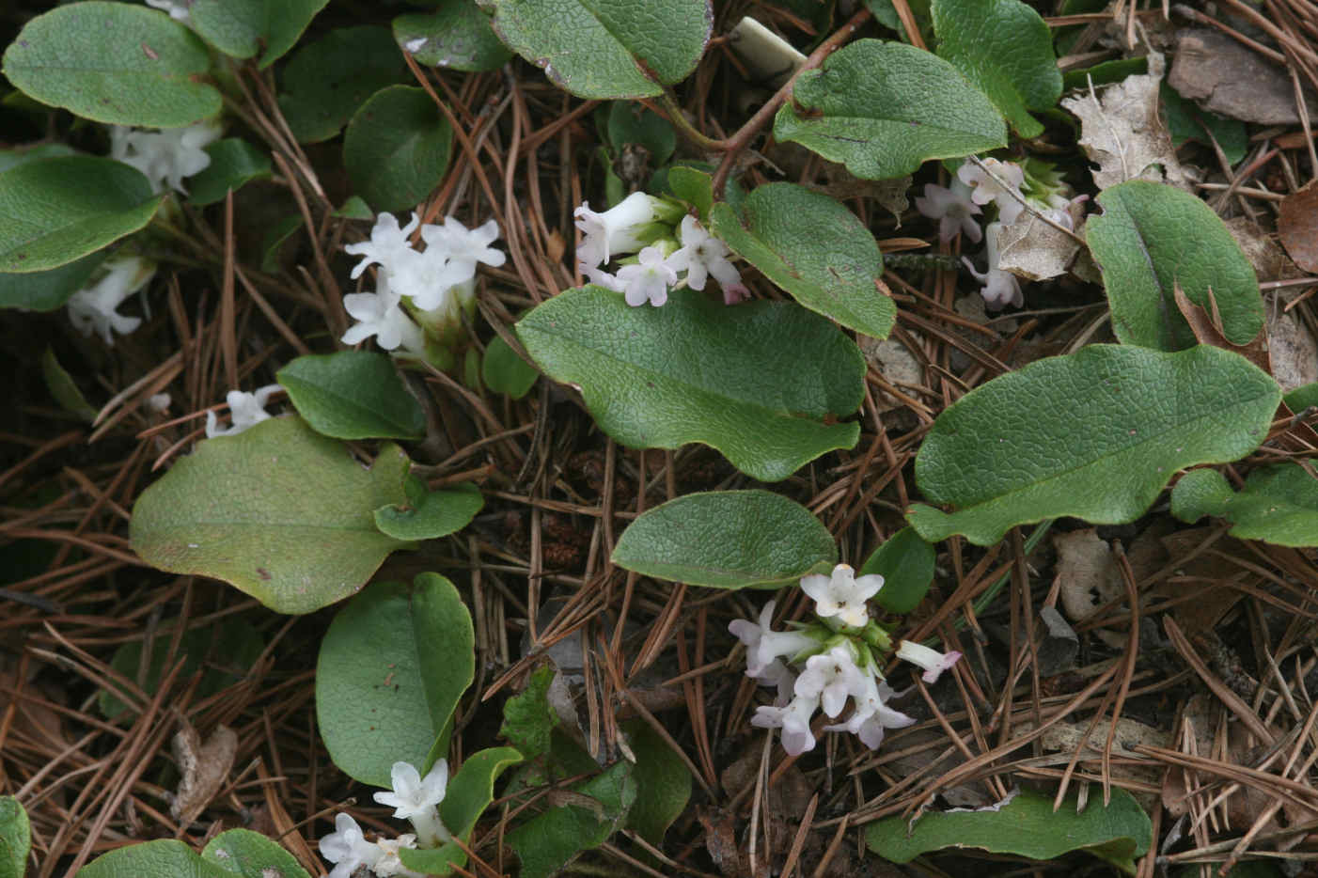

Slide 29
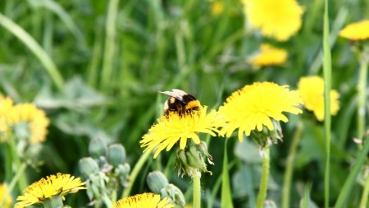

Slide 30
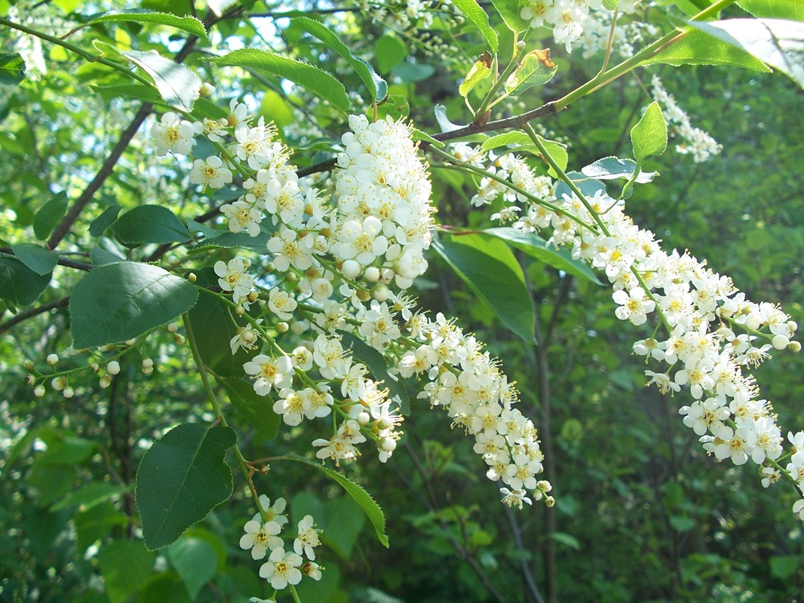

Slide 31
Pre-Season before Cranberry Blossom
Strategies
Conserve Beneficials while managing the crop
Integrated Pest Management (IPM)

Slide 32
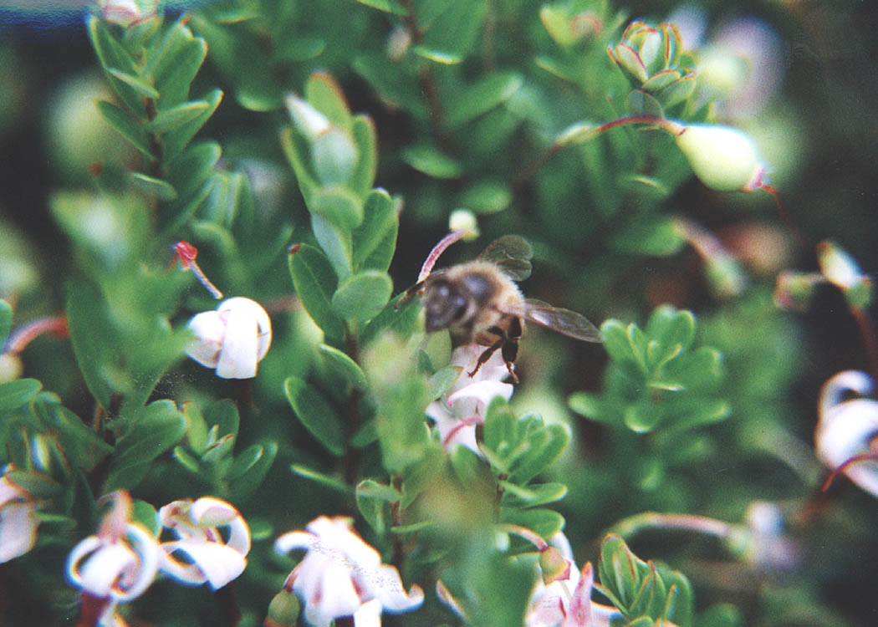

Slide 33
Cranberry Blossom
Strategies
Choose inputs with minimal pollinator toxicity
Make applications when the pollinators are not present
Minimize competitive bloom

Slide 34
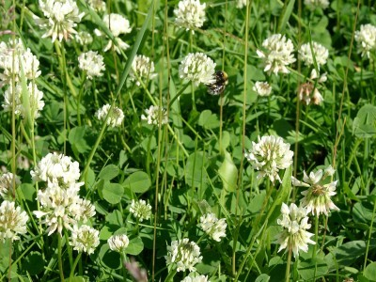

Slide 35
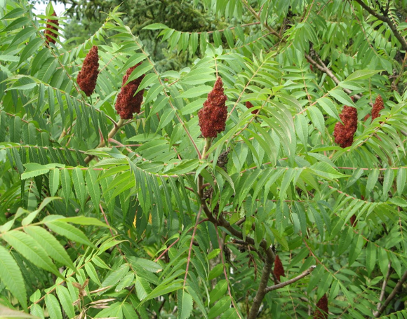

Slide 36
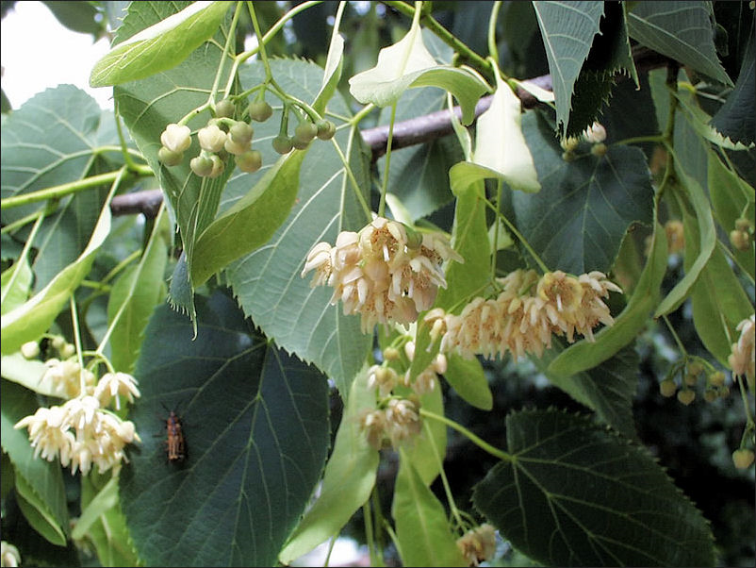

Slide 37
Post Season – After Cranberry Blossom
Important to build up populations prior to winter
Conserve pollinator plants
Augment with plantings

Slide 38
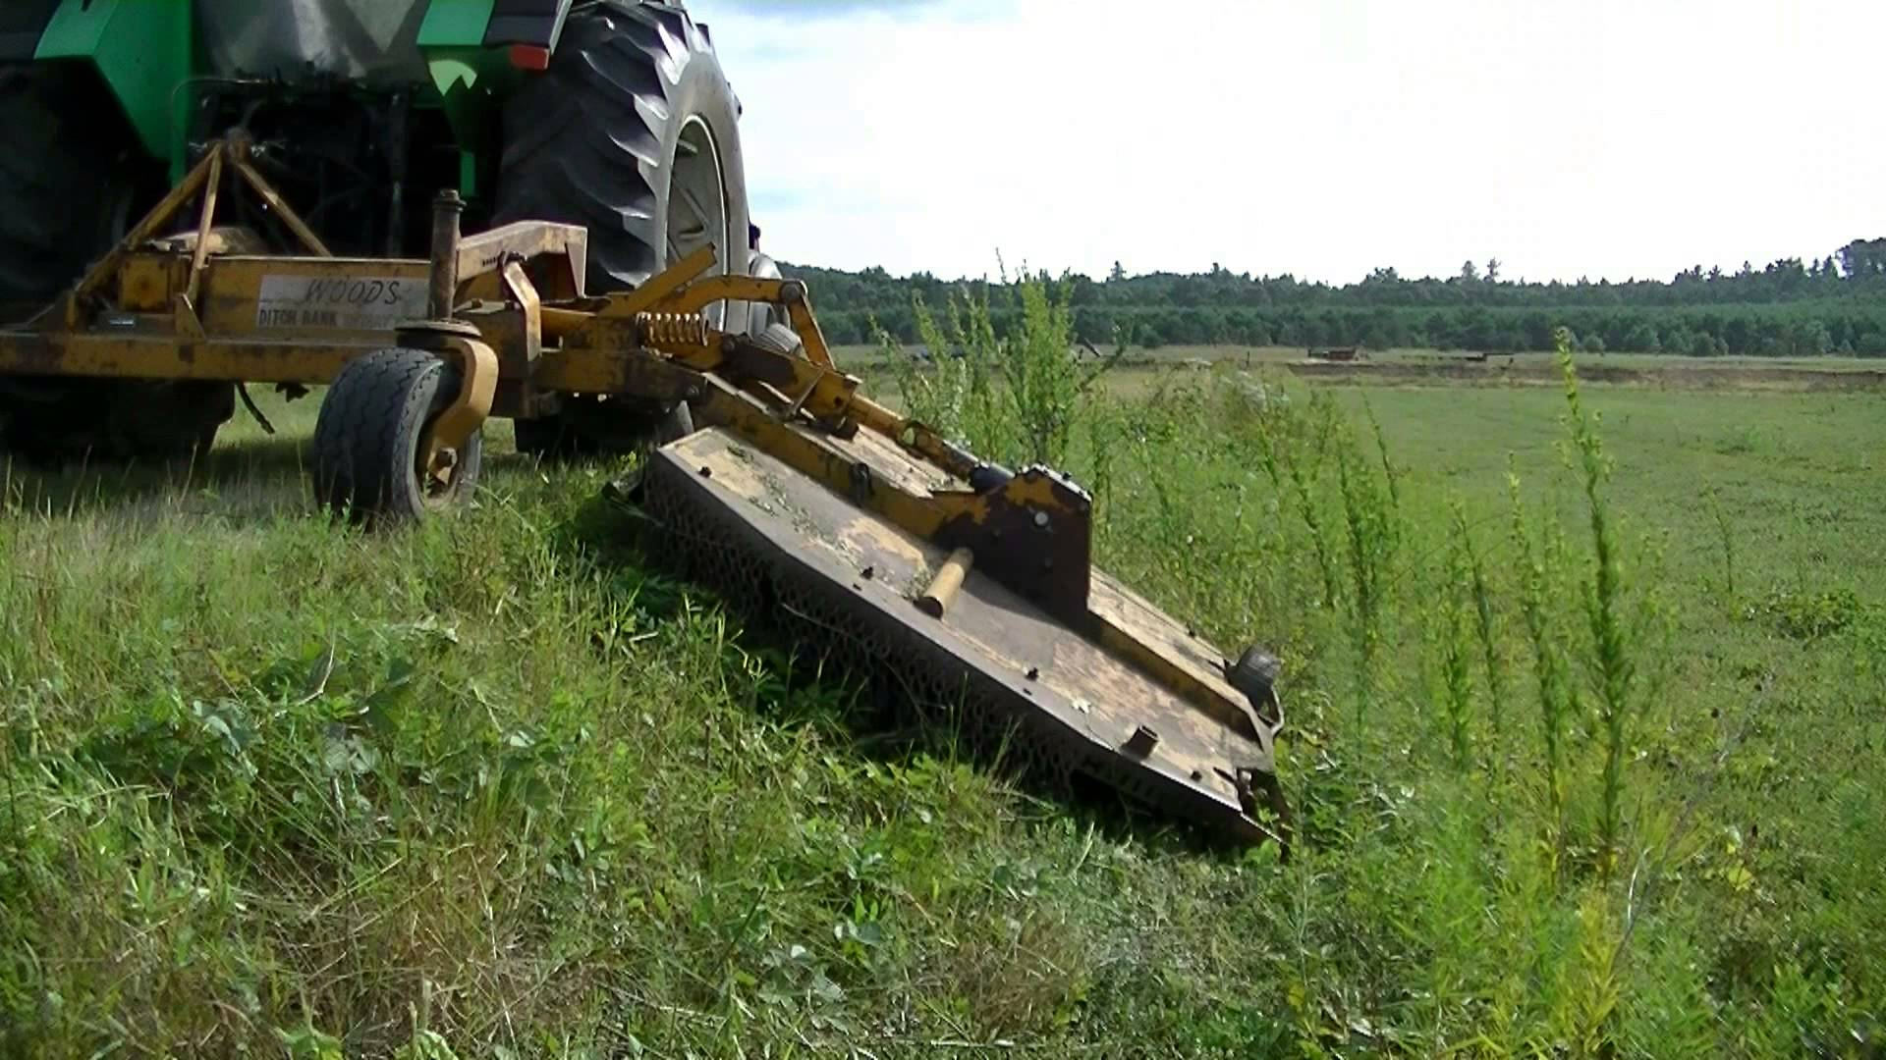
Mowing

Slide 40
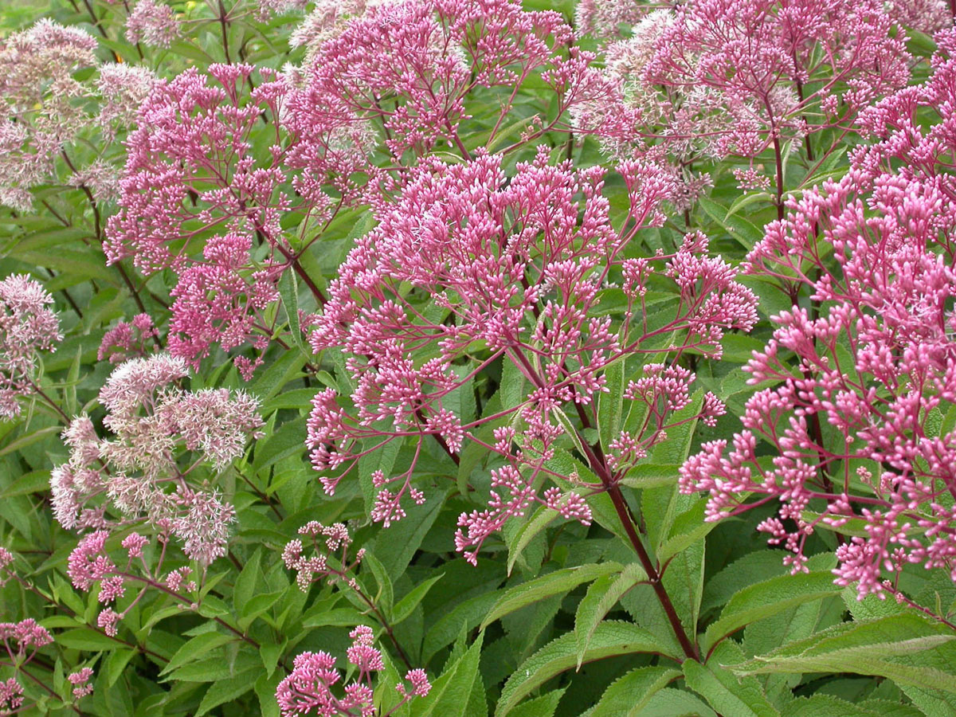

Slide 41
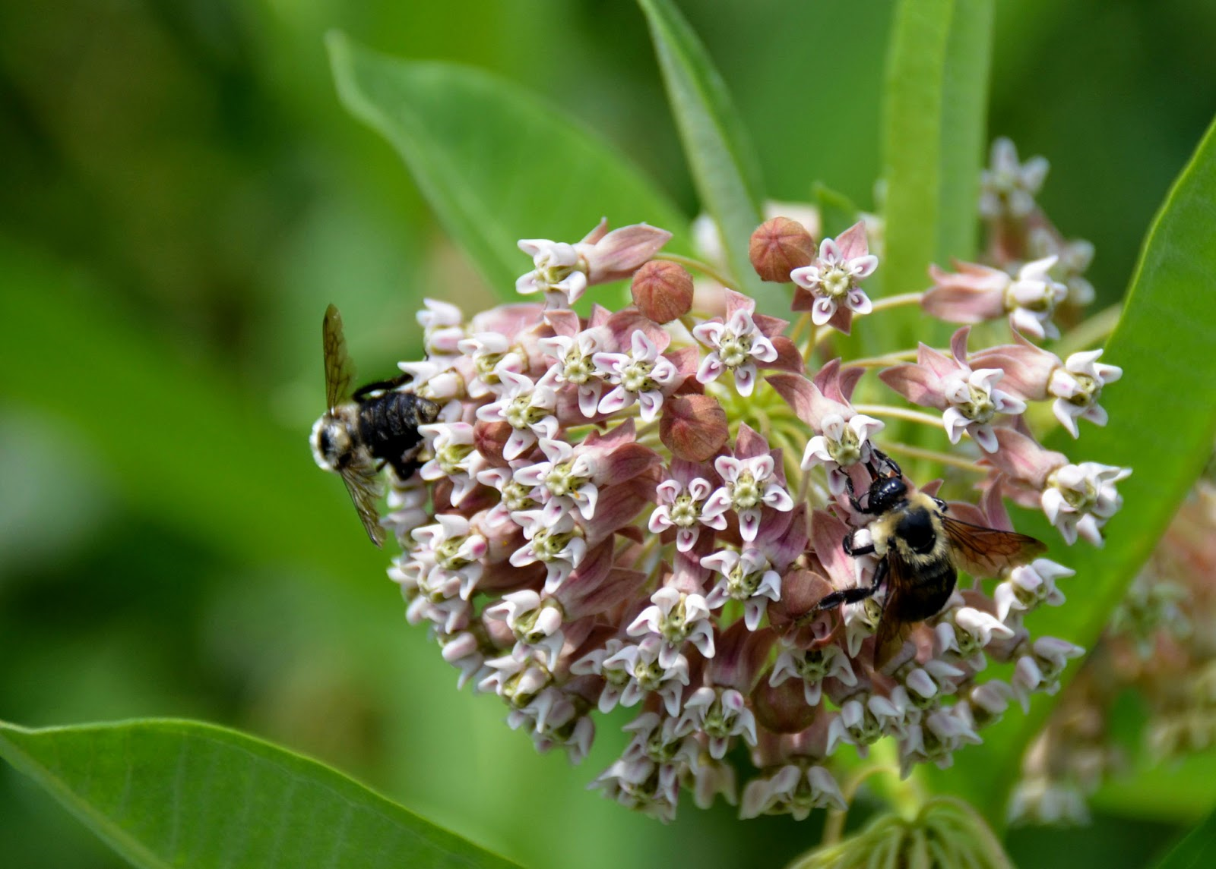

Slide 42
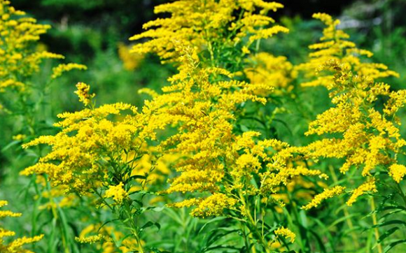

Slide 43
Augmentation Plantings

Slide 44
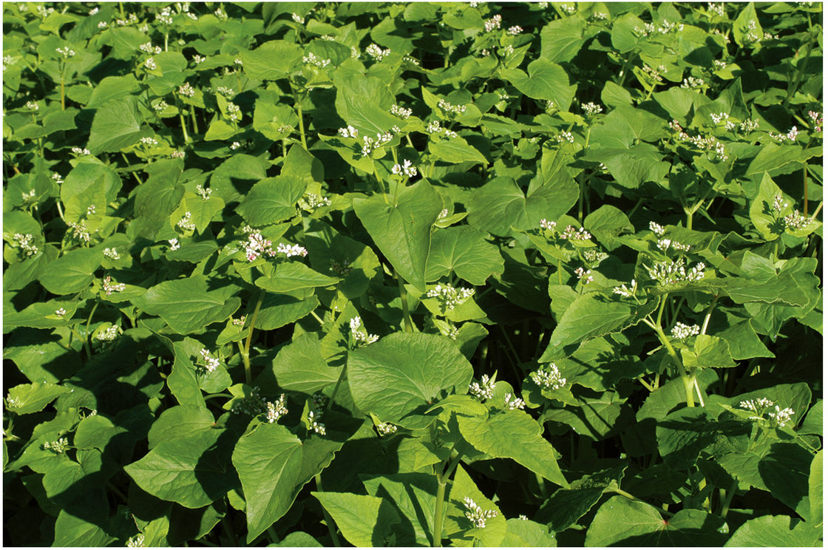

Slide 45
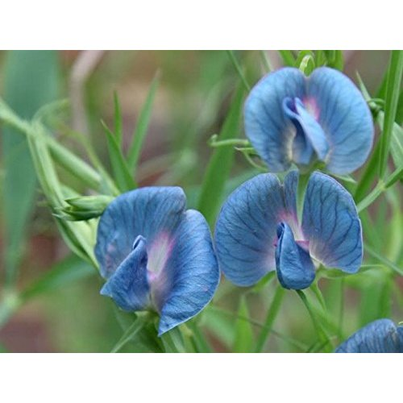

Slide 46
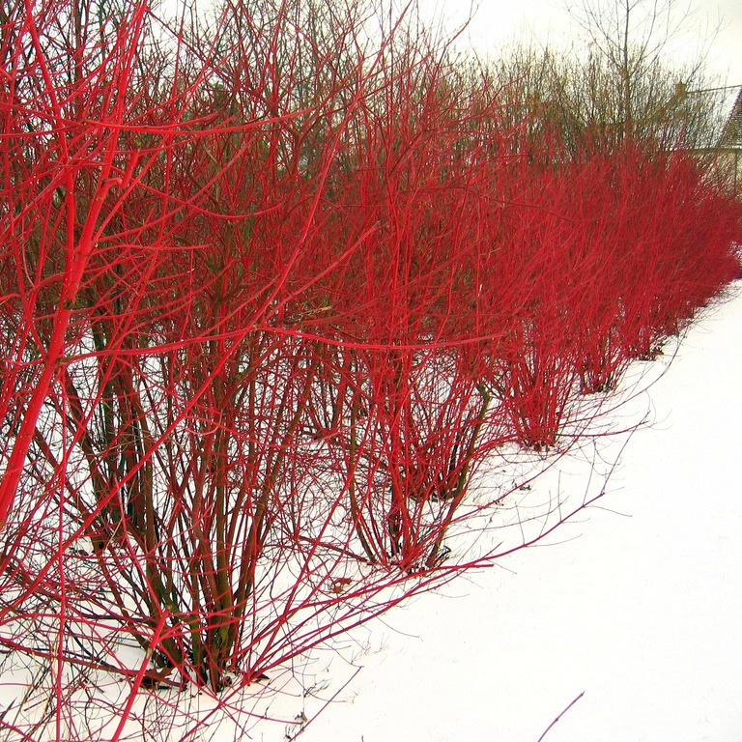

Slide 47
Native Pollinators
Commercial Bumblebees
Honeybees

Slide 48
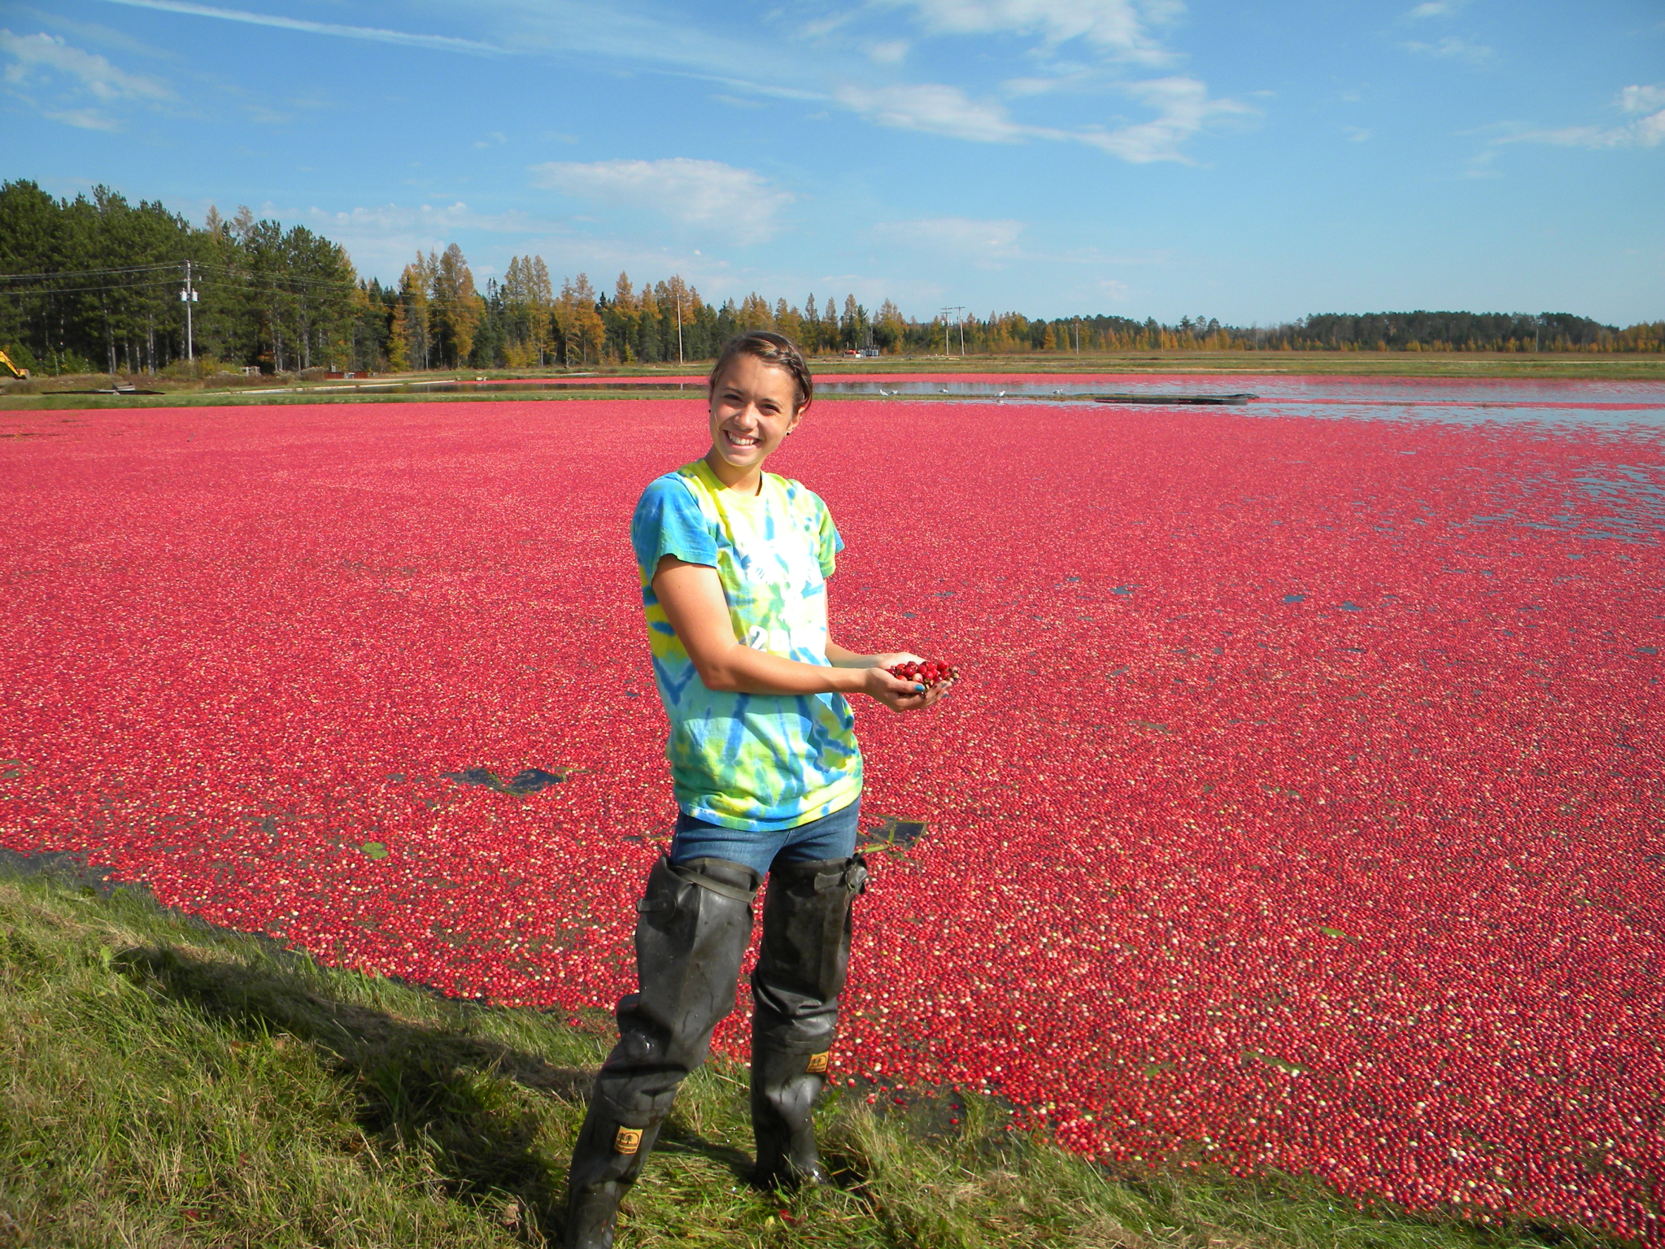
Questions?

