Slide 1
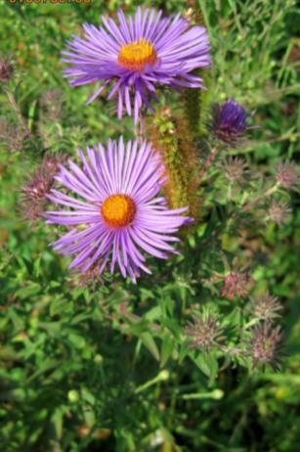
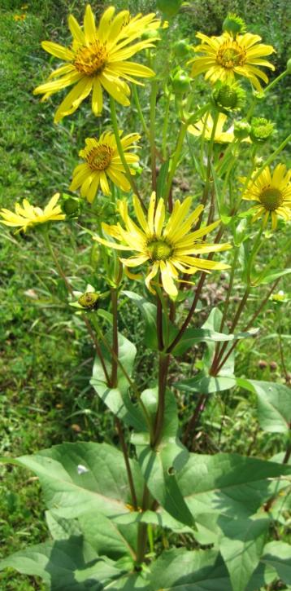
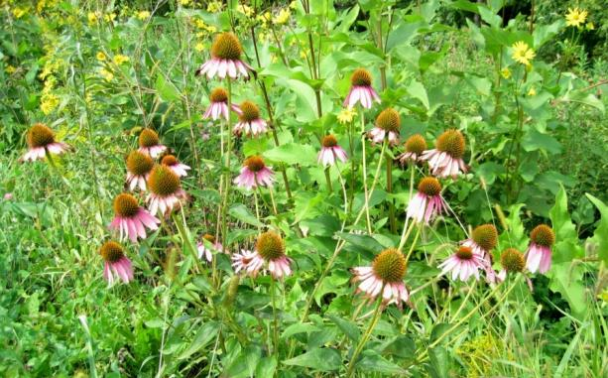
USDA NRCS Pollinators
PEGGY WINTER
USDA-NRCS

Slide 2
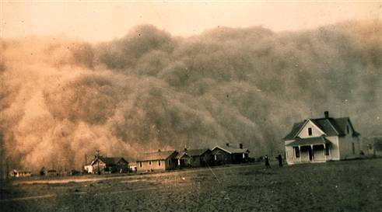
Who We Are...
The Natural Resources Conservation Service (NRCS) is the federal agency that works with landowners on private lands to conserve natural resources. NRCS was formerly called the Soil Erosion Service “SES” then Soil Conservation Service "SCS“ and finally became NRCS in 1994.
Dust storms and gullies ravaged the Nation’s farmland, stripping away millions of tons of topsoil.
Notes:
Long history of Helping People Help the Land!

Slide 3
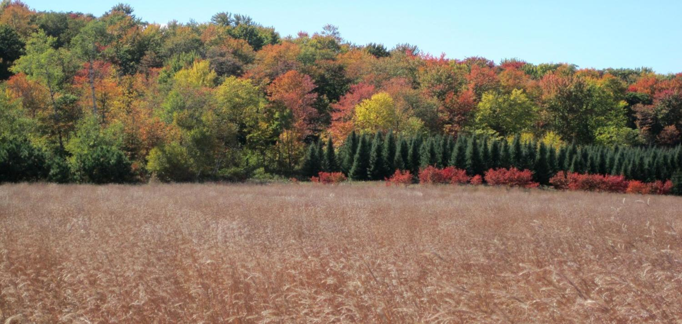
Who We Are...
Since that time, NRCS has not only kept its commitment to protecting and conserving soil but also recognized the need to establish, promote and maintain other natural resources on America’s private lands.
Mission – provide leadership in a partnership effort to help people conserve, maintain, and improve our natural resources and environment.

Slide 4
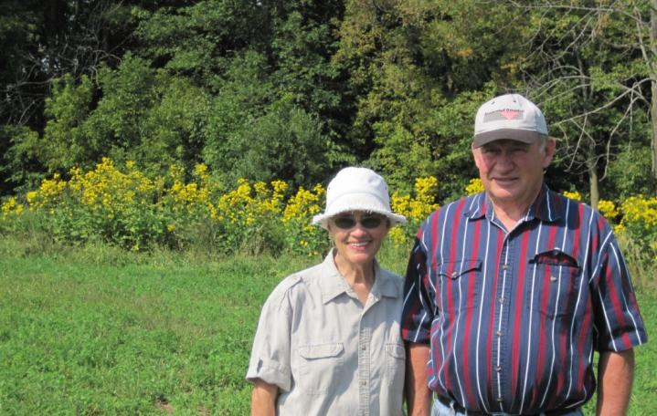
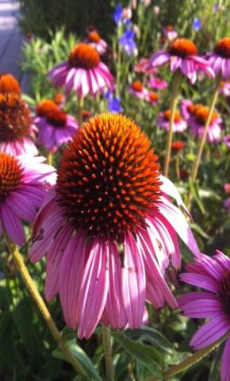
Who We Are...
We work with customers to help them reduce erosion, protect wildlife, promote good land and water use, and preserve the nation’s natural resources.
Notes:
We are fact based – science driven – customer focused.

Slide 5
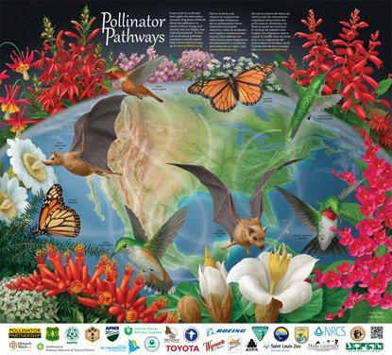
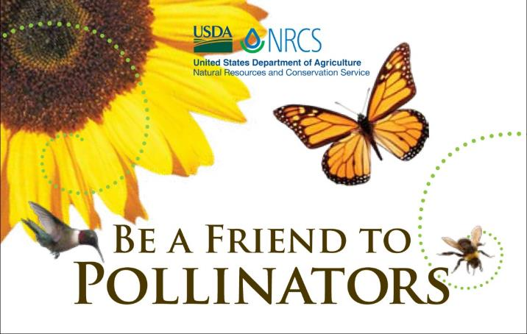
Objectives: Pollinators
Why are pollinators important?
What role do pollinators play in the survival of plants?
What can you do to promote pollinators?

Slide 6
Why are pollinators important?
Notes:
With the ease of transportation nowadays, we can get food that we never could 50 years ago. Many of the foods we consume rely on animals for pollination.
Think about this – what if you had 100 acres – what would yield more? Planting full 100 acres or planting 70 acres while leaving 30 acres around the field to forbs and legume cover.

Slide 7
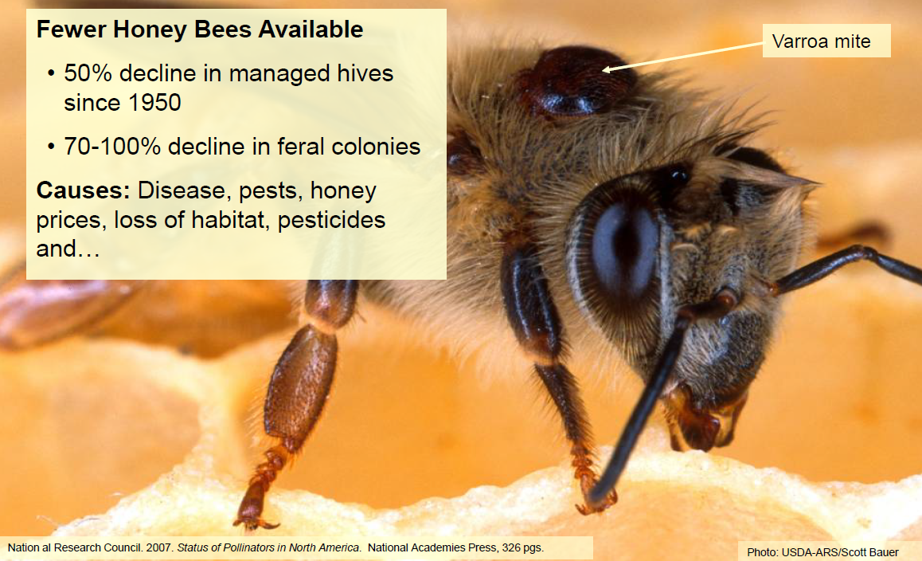
Notes:
Of the many factors that affect bee decline, Varroa mites are a major factor in the loss of bees. WHO’S HAD A WOODTICK ON THEM? The Varroa mites are like ticks on bees that suck bee blood. Infected bees come weak and are prone to viral infections.

Slide 8
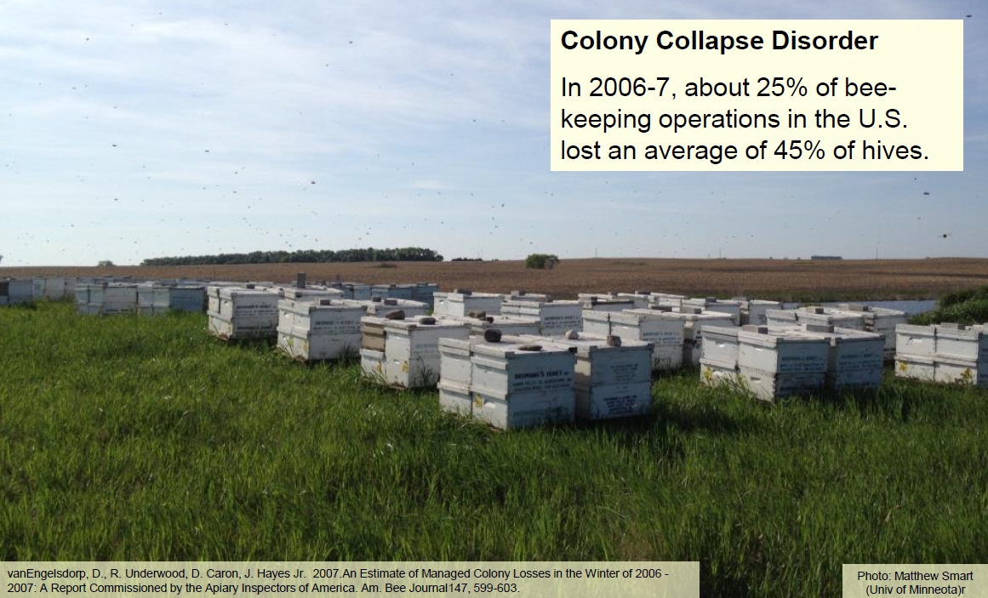
Notes:
Historically, the U.S. had as many as 6 million colonies in 1947, with declines since that time to about 4 million in 1970 and 3 million in 1990. Today‟s colony strength is about 2.5 million.
Honey bee colonies have been dying at a rate of about 30 percent per year over the past few winters.
In almond production in California, 1.5 to 1.7 million colonies currently needed. We are very close to a pollinator disaster in the almond and other pollinated crops in the U.S., This winter certainly didn’t help this situation.

Slide 9
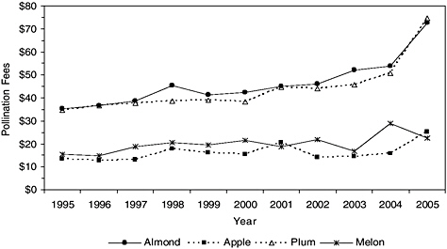
Honey Bees in Decline
Honey bee colony rental rates for selected California crops, 1995–2005.
Notes:
This graph illustrates the average cost of honey bee hive rentals for several key California crops. Note that almonds (represented by the top bar) rose from an average of $45/hive in 1995, and by 2005, as we saw bee shortages beginning to increase, the average cost rose to $75/hive.
And then, as colony collapse disorder hit the nation, this is what happened to the average hive costs that almond growers were paying…

Slide 10
2008
Honey Bees in Decline
2007
2006
Honey bee colony rental rates for selected California crops, 1995–2005.
Plus almonds, 2006-2008
Notes:
Average hive rental prices rose to almost $200.
So in just over a decade, the almond industry alone has experienced a nearly 4 fold increase in pollination costs. Keep in mind that there are over 600,000 acres of almonds in California, and the orchards are typically stocked at a rate of 2 hives per acre. At that stocking rate a little over half of all the honey bee hives in the U.S. are required for this one industry.

Slide 11
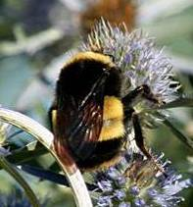
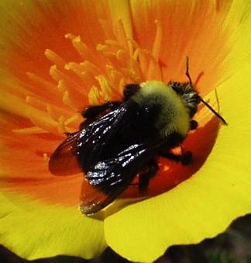
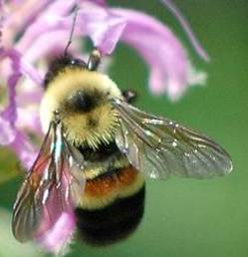
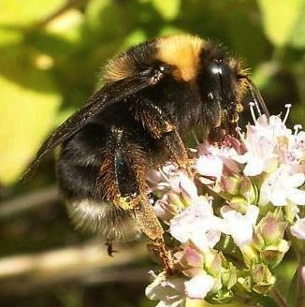
Honey Bee Declines Are Only Part of the Story
Native Bees Also in Decline
Imperiled bumble bees
Some teetering on the brink of extinction
Disease spread by commercial bumble bees
Yellow-banded
Franklin’s
© Jodi DeLong
© Peter Schroeder
Rusty patched
Western
Evans, E.,R. Thorp, S. Jepsen, and S. Hoffman Black, 2009. Status Review of Three Formerly Common Species of Bumble Bee in the Subgenus Bombus. Xerces Society.
Cameron et al. 2011. Patterns of widespread decline in North American bumble bees. PNAS
© Johanna James-Heinz
© Derrick Ditchburn
Notes:
11
Many of our native bees are also in decline.

Slide 12
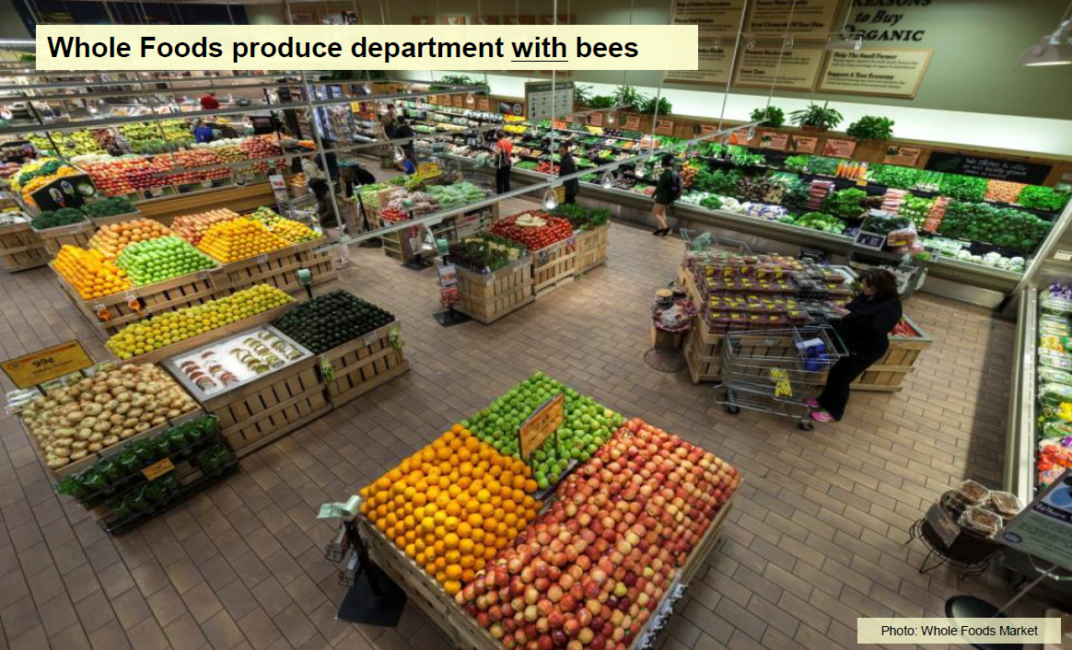
Notes:
THINK ABOUT THIS…
When you go to the grocery store –do you stand there & evaluate “what in the produce department is there because of pollinators?” Let’s admit, most have their list, your in and out trying to dodge other carts and avoid the slowest check out line. RIGHT :O)
Well…..check this out!

Slide 13
Notes:
What is we didn’t have pollinators!
Will you view the produce department the same or even your next trip to the grocery store?

Slide 14
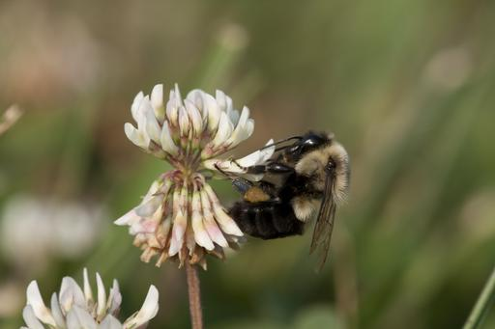
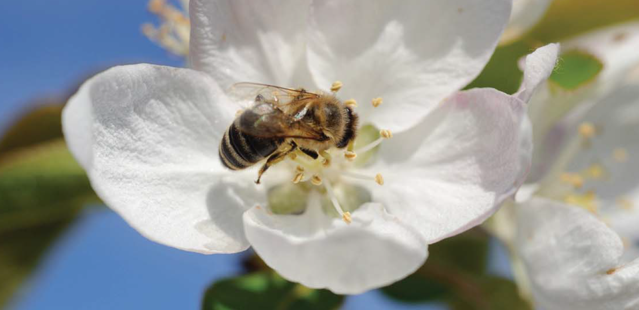
Roles of pollinator:
Provide genetic variation in plants/crops
Disease, Pest, Adaptation
What happen if pollinators are taken out of this picture?
Notes:
It’s obvious that pollinators pollinate flowers so plants can set viable seeds. Along with that, we get to enjoy the fruits, nuts, and other products that comes along with the seeds.
Pollinators are one of the key factor in providing genetic variation in plants. Genetic variation in any species helps that species to adapt to changing environments, resist new diseases and pests.

Slide 15
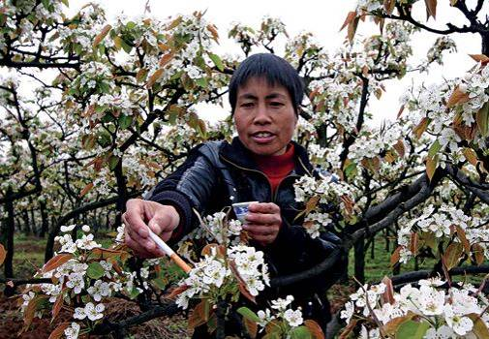
Pollination and Crop Security
What does all this mean for the sustainability of crop pollination?
Photo: Business Week
Notes:
Perhaps an unsettling glimpse into our future comes from China, one of the largest apple-producing regions in the world, where….. the majority of the crop is pollinated this way, by hand.

Slide 16
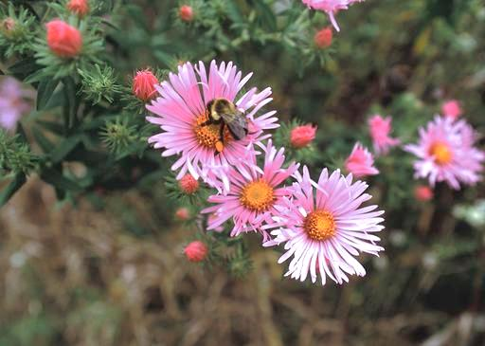
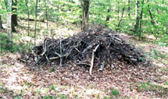
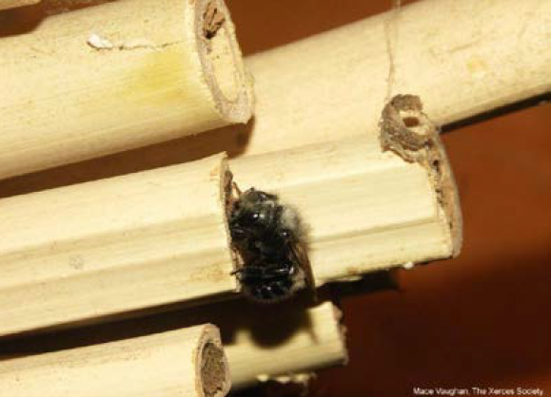
What can you do to promote pollinators:
What do pollinators need to survive?
1. Food
2. Cover/shelter
3. Pesticide free environment
Notes:
There is no single silver bullet that solve the problem affecting the decline of honey bees and other pollinators. But there are many factors we know that does play a role their decline.
Before we can do anything to help pollinators, we need to know what they need to survive.
Lack of suitable food or foraging plants will have a negative impact on the survival of pollinators. Even with enough food source, without the right food source, pollinator’s life span can decline as much as 10%.
Having adequate cover and shelter impacts their survival over winter. 70% of native bee species in the US are ground nesting bees and the other 30% are wood nester. Having waste land, unproductive land, brush pile, dead trees are actually very beneficial to pollinator in provide shelter and cover for many of our native pollinators.
Pesticide free environment would be ideal of pollinators, but sometime we may need to spray for pest. Taking precaution when we need to spray will minimize the impact on pollinating species.
Spraying at night, spray at lower pressure, use adjuvant to increase droplet size, use drift reducing nozzles, avoid spraying on windy day, avoid spraying on hot morning after cool nights, or other method that are target specific.

Slide 17
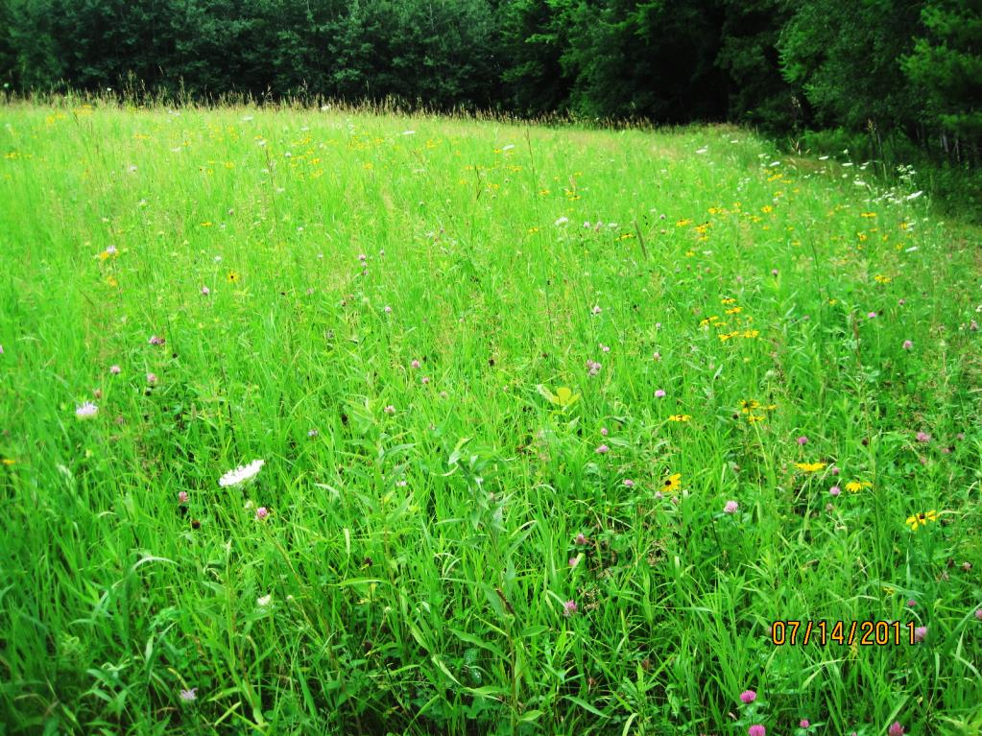
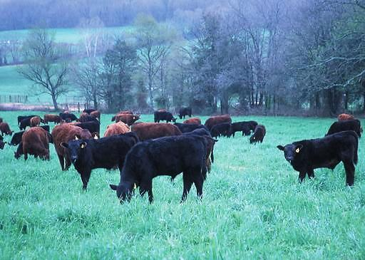
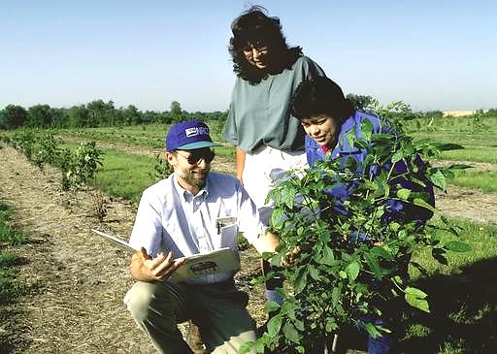
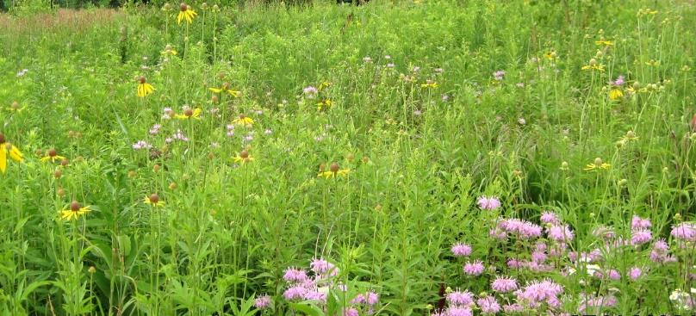
What can you do promote pollinators:
Practices that benefit pollinators are:
Pollinator Cover
Introduced and/or Native species
Forage and biomass planting – crop & pasture
Prescribed grazing
Trees and/or Shrub plantings that benefit pollinators
Forage Harvest Management
Field borders
Cover crops
Notes:
Pollinator cover: Can be anywhere. Around house, yard, along creeks, pretty much any areas where we think it is useless.
-Native species are preferred as native pollinators have evolved along with native plants, therefore native pollinators are much more efficient at pollinating our native plants. You only need 250 mason bees to pollinate an acre of apples. You will need 15,000-20,000 honey bees or about 2 hives. Native bees are more active in colder and wetter conditions. Going back to food source: Native plants provide the proper nutrition for native pollinators.
-Selecting plants that bloom in spring, summer and fall.

Slide 18
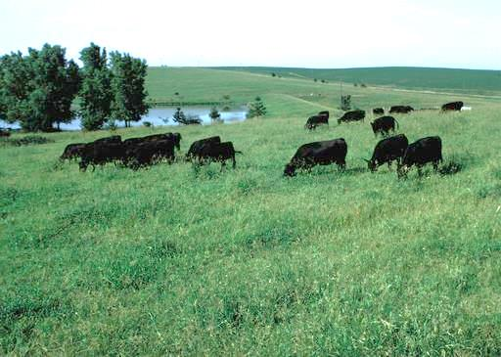
Environmental Quality Incentives Program (EQIP) Honey Bee Initiative
How USDA is promoting pollinators:
Conservation Stewardship Program (CSP)
Conservation Reserve Program (CRP)
Notes:
EQIP: refer back to prior slide
CSP: Drift reducing method, pollinator habitat plantings, field borders with pollinator species, cover crops, GPS targeted spraying, incorporating natives into pasture, managing haying, creating shallow ponds, restoring prairie habitat, biological suppression of pest, weeds, and invasive species.
CRP: doing similar practice as EQIP and CSP.

Slide 19
NRCS Honey Bee Pollinator Effort
Honey Bee Effort launched in 2014-2015 to… Improve honey bee food sources
Improve foraging plants
Develop & implement integrated pest management
Tweak management of intensive grazing systems

Slide 20
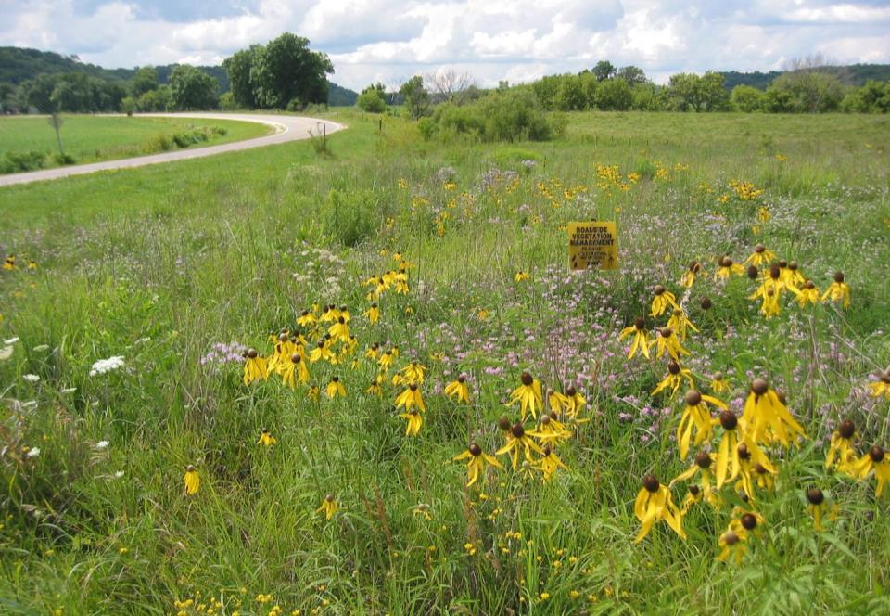
Native Plantings
Conservation Cover: Diverse wildflowers that bloom through season.
Emphasizing plants that are most beneficial to bees and bloom throughout the year.
Notes:
Be sure to have: early – mid and late “bloomers” in the mix!

Slide 21
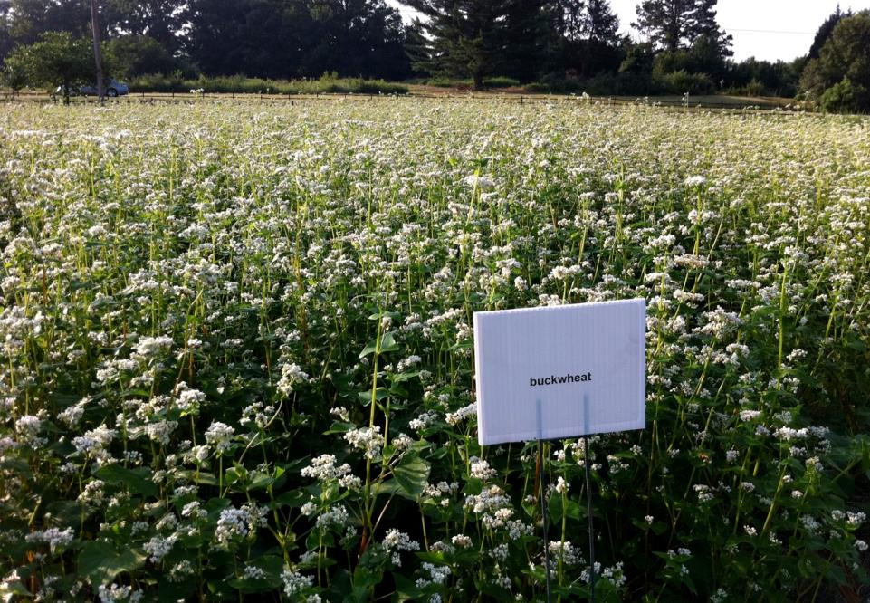
Honey Bee Habitat Effort in Forage Plots
Honey Bee Food Plots
New Practice started in 2016
White clover, alsike clover, buckwheat, sunflower
Replaced cover crop practice
More species to be added for 2018
Notes:
New Job Sheet coming out THIS WEEK.
Minimum none grass species – oats & millet

Slide 22
Honey Bee Food Plot – “Cover Crop” Mix Sample
Sun Hemp
Sample Mix
Sunn Hemp - 5 lbs/ac
Buckwheat - 10 lbs/ac
Berseem Clover - 2 lbs/ac
Crimson Clover - 2 lbs/ac
Flax- 4 lbs/ac
Cowpeas - 5 lbs/ac
Forage Turnip - .4 lbs/ac
Forage Brassica -.4 lbs/ac
Rape - .4 lbs/ac
Notes:
Similar species found in deer food plots!

Slide 23
Which conservation programs allow hives? CRP - Yes EQIP - Yes CSP - Yes WRP- No
How can we promote Honey Bee forage?
Cover crops
Deer food plots
Soil health
Annual grazing forage

Slide 24
Participant Eligibility for NRCS Programs
Be a producer – engaged in ag production or forestry mgmt. & have interest in the operation
Have control of the land for the contract term
Land offered is ag land, private forest land, or other ag land which ag or forest products are produced
Must be in compliance with highly erodible and wetland conservation compliance provisions

Slide 25
Beginning Farmer Eligibility
Have not operated a farm or ranch, or has operated a farm or ranch for not more than 10 consecutive years
Will materially and substantially participate in the operation of the farm or ranch
If eligibility is met up to 90% cost share may be available for conservation practice implementation

Slide 26
Trees and shrubs for Bees!
Locust
Basswood
American Elm
Black Cherry
Common Hackberry
Northern Catalpa
Ohio Buckeye
Pussy Willow – very early
American Plum -early
Buffaloberry –early
Golden or Black Currant –early
Nannyberry - mid
Common Chokecherry - mid
Silky Dogwood & Red Osier Dogwood- mid
Common Elderberry – mid to late
Native Roses - late

Slide 27
Native Forbs/Legumes Beneficial to Bees
Mountain Mint
Purple Prairie Clover
Sneezeweed
Common & Swamp Milkweed
New England, Sky Blue & Smooth Aster
Stiff & Showy Goldenrod

Slide 28
Native Forbs Benefiting Honey Bee
RECOMMENDED NATIVE FORB SPECIES BENEFITTING HONEY BEES |  | Bloom Color pp | Flowering Season Early = April – June Mid = June – August Late = August – October
Butterfly Weed | (Asclepias tuberosa) | Orange | July - August
Canada Milkvetch | (Astragalus canadensis) | Cream | June - August
Culvers Root | (Veronicastrum virginicum) | White | June - August
Ironweed | (Veronia fasciculata) | Purple | July - September
Pale Purple Coneflower | (Echinacea pallida) | Pink | June - July
Rough Blazingstar | (Liatris aspera) | Purple | July - September
Showy Goldenrod | (Solidago speciosa) | Yellow | July - September
Showy Penstemon | (Penstemon grandiflorus) | Lavender | May - June
Smooth Aster | (Aster laevis) | Blue | August - September
Spotted Beebalm | (Monarda punctata) | Lavender | July - September
Canada Tick Trefoil | (Desmodium canadense) | Purple | July - August
Foxglove beardtongue | (Penstemon digitalis) | White | May - June
Giant Sunflower | (Helianthus giganteus) | Yellow | July - October
Mountain Mint | (Pycnanthemum virginium) | White | June - September
Partridge Pea | (Cassia fasticulata) | Yellow | July - September
Boneset | (Eupatorium perfoliatum) | White | August - September
Cup Plant | (Silphium perfoliatum) | Yellow | July - September
Joe-pye Weed | (Eupatorium maculatum) | Rose | July - September
New England Aster | (Aster novae-angliae) | Purple | September - October
Panicled Aster | (Aster lanceolatus) | White | August - October
Sneezeweed | (Helenium autumnale) | Yellow | August - October
Swamp Milkweed | (Asclepias incarnata) | Red | June - July
Common Milkweed | (Asclepias syriaca) | Purple | June - August
Giant Hyssop | (Agastache spp.) | Purple | July - October
Leadplant | (Amorpha canescens) | Purple | June-September
Purple Prairie Clover | (Petalostemum purpurum) | Purple | July - August
Showy Sunflower | (Helianthus laetiflorus) | Yellow | July - October
Stiff Goldenrod | (Solidago rigida) | Yellow | August - September
White Prairie Clover | (Petalostemum candidum) | White | June - September
Bold species are considered highest value to honey bees.

Slide 30
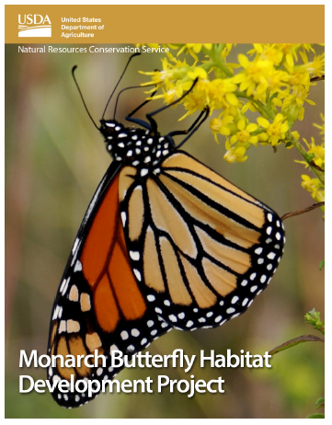
Monarch Initiative Overview
National Strategy: “All hands on deck”
USDA’s strategy:
Farm Service Agency
Conservation Reserve Program
Natural Resources Conservation Service
Environmental Quality Incentives Program
Conservation Stewardship Program
Wetland Reserve Program
Agricultural Conservation Easements Program
Notes:
LAUNCHED in 2015.

Slide 31
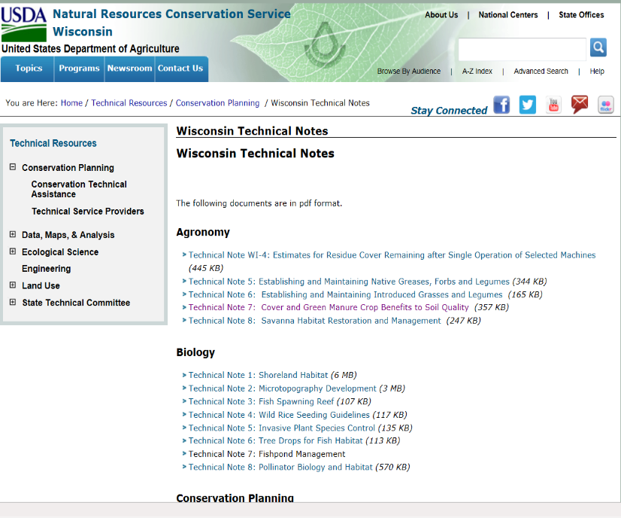
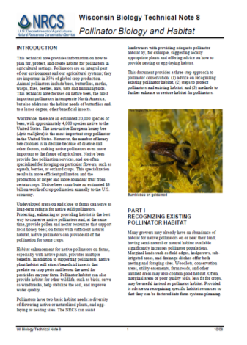
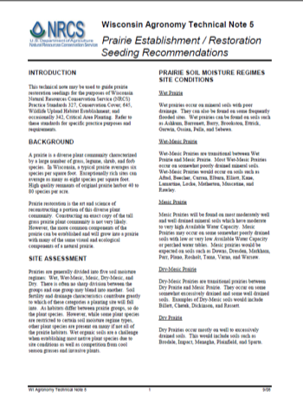
Resources
The WI USDA NRCS website is full of technical resources that can be used for education and planning purposes!
www.wi.nrcs.usda.gov

Slide 32
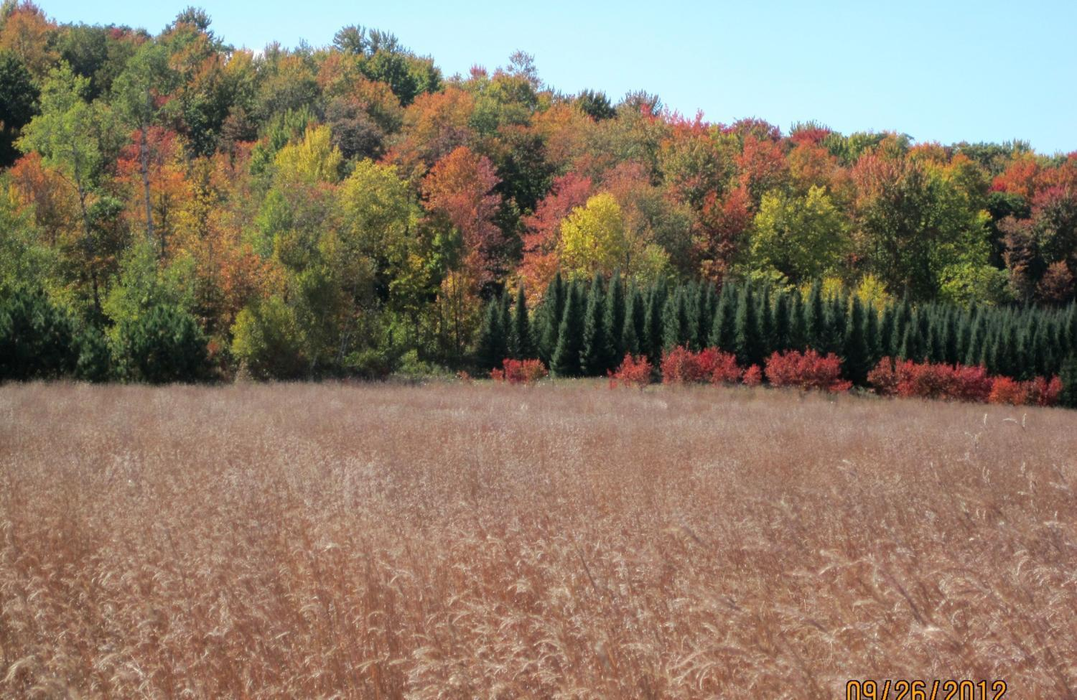
Where are we located?
Rhinelander (Vilas, Oneida, Forest, Florence) USDA-NRCS Service Center Address: 2187 N Stevens Street, Suite A
Langlade - Lincoln USDA-NRCS Service Center Temporary Address: 2187 N Stevens Street, Suite A
Antigo Address: 803 Superior St, Antigo, WI
Website: www.wi.nrcs.usda.gov
Notes:
HANDOUT on table for statewide – share information with friends and family!

Slide 33
Questions?
The U.S. Department of Agriculture (USDA) prohibits discrimination against its customers, employees, and applicants for employment on the bases of race, color, national origin, age, disability, sex, gender identity, religion, reprisal, and where applicable, political beliefs, marital status, familial or parental status, sexual orientation, or all or part of an individual's income is derived from any public assistance program, or protected genetic information in employment or in any program or activity conducted or funded by the Department. (Not all prohibited bases will apply to all programs and/or employment activities.)

