Slide 1
est. 2005
Monarch March is a volunteer group that is dedicated to keeping the Monarch Butterfly off the endangered species list.

Slide 2
Egg - 3-4 days
• They are football shaped with
ridges.
• Top of the egg turns black
before the caterpillar emerges.
• Females can lay around 400 eggs.
• 1 in 100 will survive to maturity
in the wild.

Slide 3
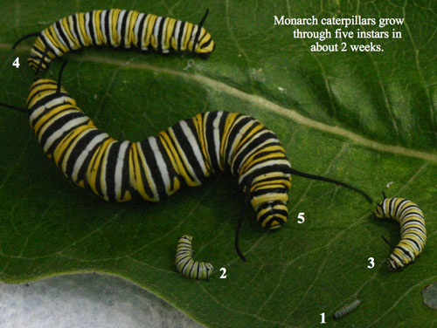
Larva - (Caterpillar) 10-14 days
Approx length Instars (shed):
• 1st shed, 4mm
• 2nd shed, 8mm
• 3rd shed, 12mm
• 4th shed, 20mm
• 5th shed, 35mm
Their size increases nearly 10x in 2 weeks!

Slide 4
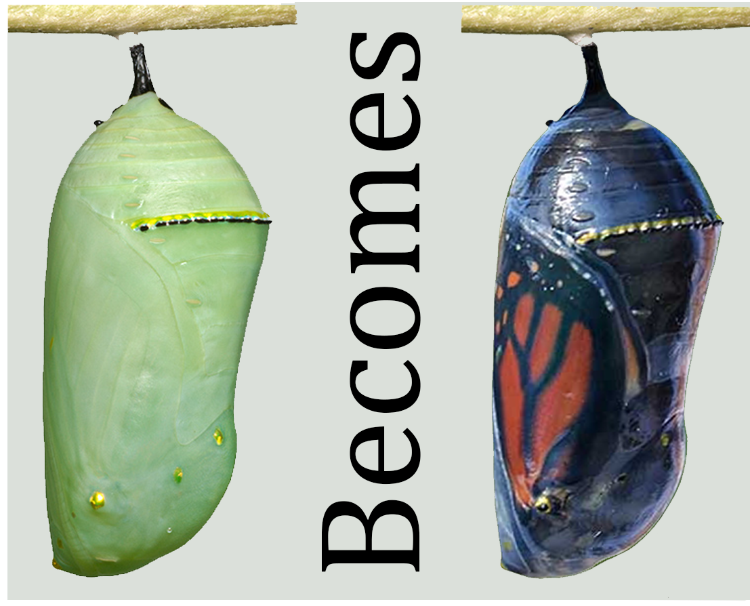
Pupa - (Chrysalis) 10-14 days
• The Larva will spin a silk button,
attaching itself, Then hanging
head-down in a “J” shape.
• Shedding its skin, leaves it encased
in a clear (not green) exoskeleton.
• When ready to emerge, wings are
visible through the pupa covering.
• This stage lasts only about 10 to 14
days.

Slide 5
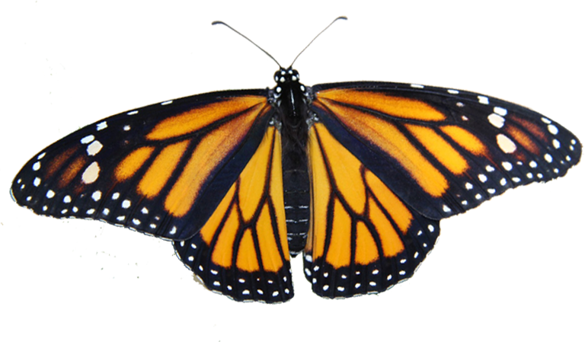
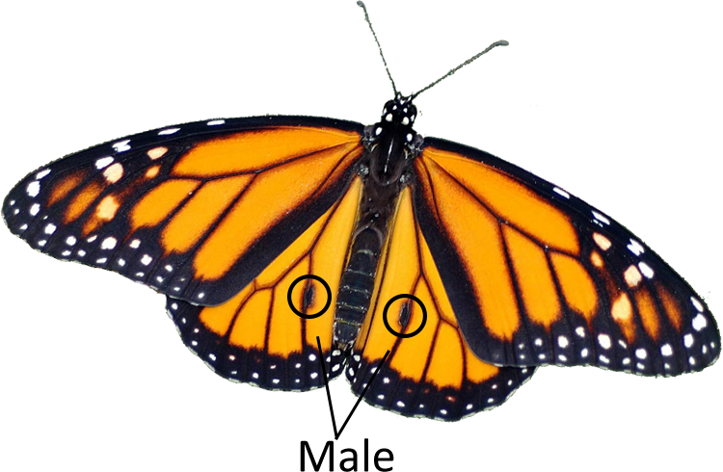
Adult - 4-6 weeks
• Monarchs can fly about 4 to 12
miles an hour.
• Adult Monarchs will live another
2 to 6 weeks.
• Monarchs that migrate in the fall,
live about 6 to 9 months.
• An adult goes from egg to adult
in about 30 days.
Female
Females have thicker wing veins, giving her a darker appearance.
Males have a black spot on each hind wing.

Slide 6
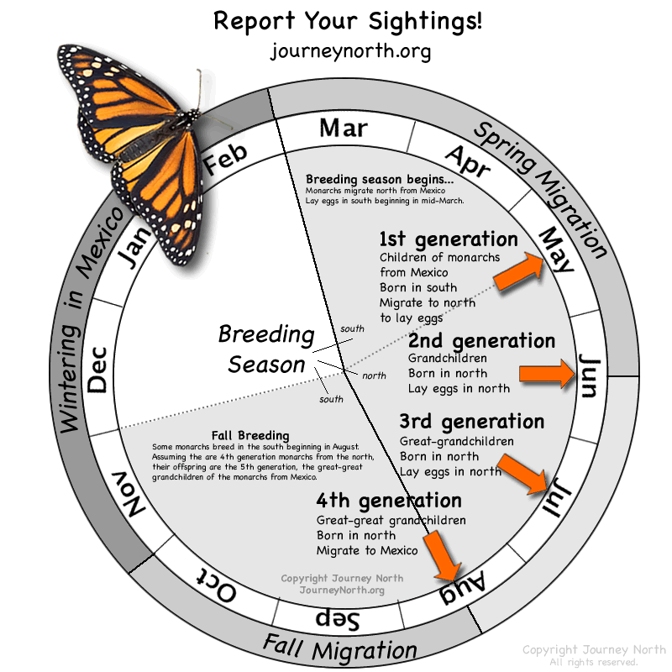
Generations
First year:
• Mar - Last year's butterflies leave Mexico
flying to Texas to breed and lay eggs.
• May - 1st born in Texas migrating north
breeding and lay eggs.
• June - 2nd reach northern states and Canada
breeding and lay eggs.
• July - 3rd breed and lay eggs.
• Aug - 4th migrate back to Mexico.
Next year:
• Mar - 4th leaves Mexico, returning to Texas
to start the cycle all over.

Slide 7
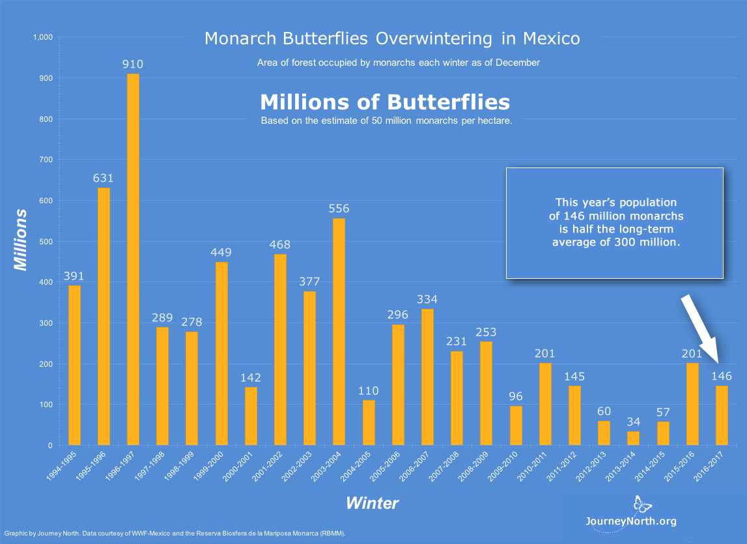
Some perils they face
Naturally Perils
• Parasite (OE)
• Tachinid Flies
• Wasps
• Ants
• Spiders
Manmade Perils
• Cars
• Food shortages
• Pesticides
• Weed killer
• Habitat loss USA & Mexico
In 23 average has dropped by 60%

Slide 8
Things we have done to help
• Raising them indoors has increased
odds of survival to over 95%.
• Speaking to groups & schools
• Supplying milkweed & caterpillars
• Tagging & releasing to help better
track migration patterns

Slide 9
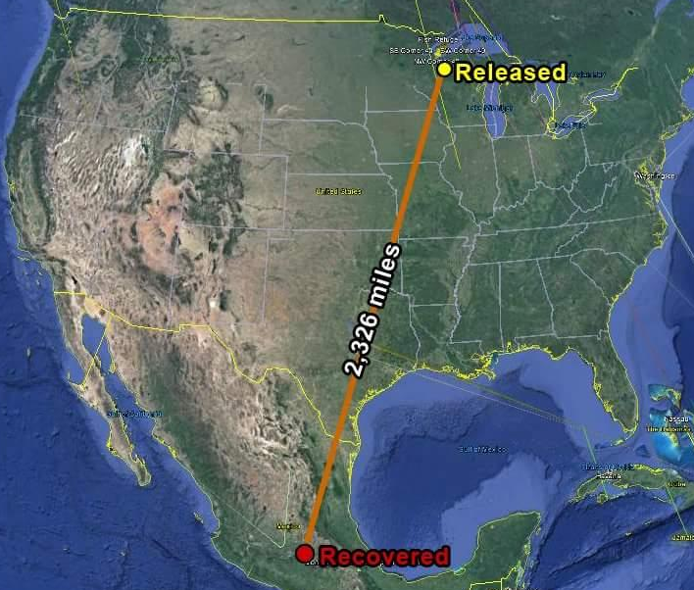
Things you can do to help
The Monarch flies from Rhinelander, WI
• Plant milkweed
• Start a butterfly garden and register it
as a waystation.
• Don’t use insecticide or weed killer
• Spread the word
• Report your sightings to Journey
North
around 2,326 miles to El Rosario, Mexico

Slide 10
For helpful information look for these websites.
Search
Journey North
(contact for sightings)
Monarch Watch
(Tags & Waystations)
On Facebook
The Beautiful Monarch
(Education)
Monarch March
(Our site)
If you would like to raise your own monarch. Please feel free to contact us with any questions or concerns.
Paula 1-715-513-6216 monarch.march@gmail.com
Luann 1-715-600-0776 luannrogers10@gmail.com

